Slide 1


Slide 2

How it all began
A vision to better support children through collaboration

Slide 3
How it started/ Formation in November 2025
First OMT/HCI workshop Nov 2025:
Facilitated session 1: What should we be focussed on as a collective to maximise our impact
Facilitated Session 2: Community contracting - How to facilitate learning and sharing in our community
Facilitated session 3: What are the inhibitors & enablers to the collective action? What support may be required?
fruitful working group activities between Zero2Five, THANDA and LETCEE
KwaZulu-Natal: great province for such pilot
invited Lulamaphiko, Singakwenza and Midlands Community College to join
With the main goal of exploring collaborative, ongoing work addressing the complexity of improving early learning outcomes by sharing experiences, challenges, ideas, encouragement, tools and other resources

Slide 4







Slide 5
Shared Missions: Combining resources and expertise to address poor ELOM outcomes with urgency for 2026.
Clear Goals and Expectations: Defining objectives for microchanges in 2 ELOM domains per organization to ensure focus.
Cultivating a Safe Space: Enabling open dialogue to transparently share challenges of all types.
Mutual Growth: Fostering collaboration and a sustainable framework for ongoing, endless ECD learning.
Routine Transformation: Shaking and brightening up the daily work for directors, trainers, and facilitators.
These combined elements have led to a more impactful response to the current early learning crisis than any of us could achieve alone.

Slide 6
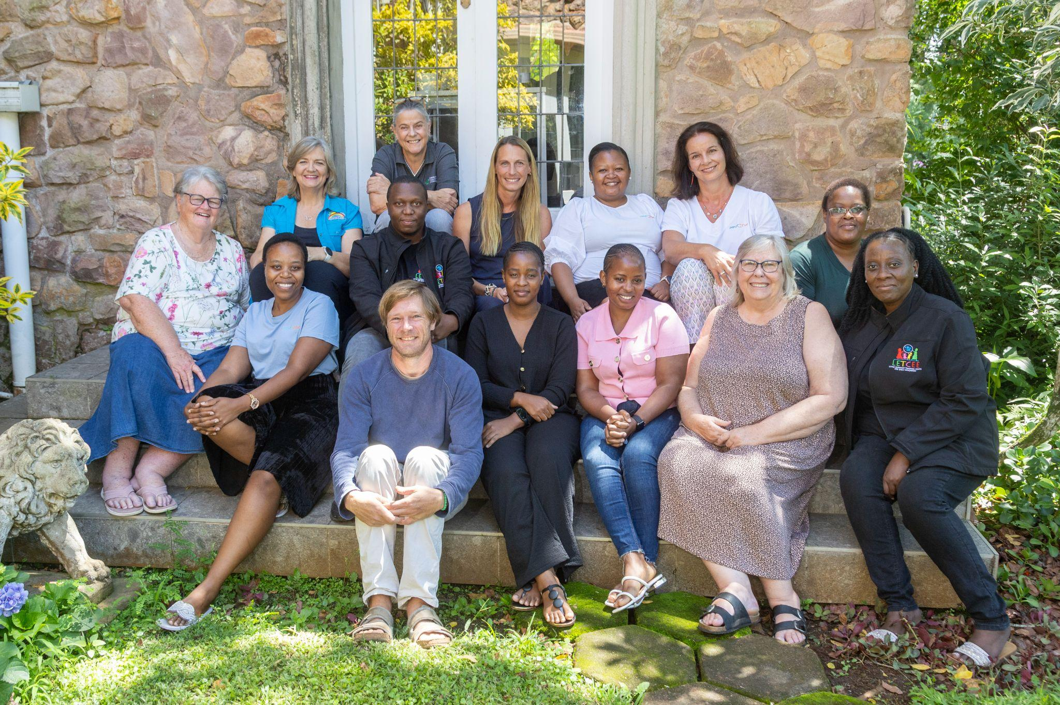

Slide 7
Utilising ELOM to Identify Strengths & Weaknesses
A way to match challenges to opportunities

Slide 8
Interrogation of several prior years’ ELOM end-year results to identify domains with greatest weaknesses across several organisations.
Chosen domains also aligned with Thrive by Five areas of greatest weakness.
Same domains were areas of strength in other organisations (strengths-based approach)

Slide 9
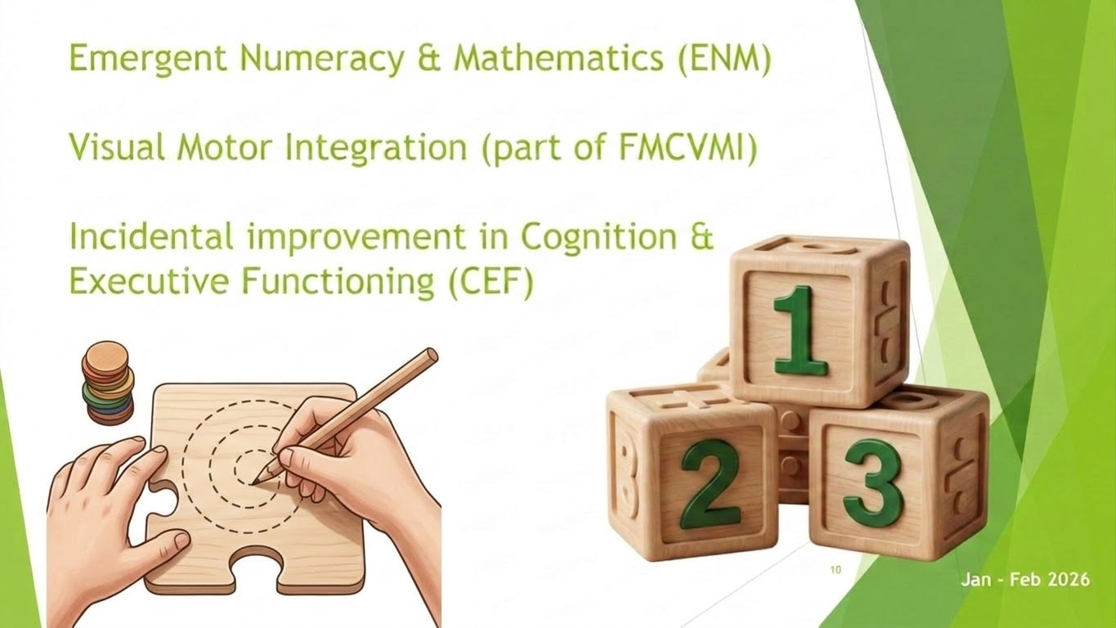

Slide 10
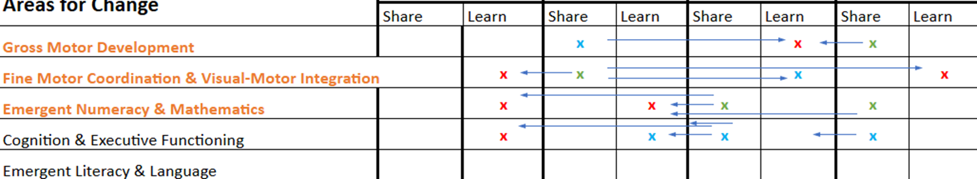
Conclusion: we have proven solutions amongst us - ones that have already been tried and tested on the ground, in similar situations, over time.
There was an opportunity for sharing & learning.

Slide 11
Identifying Micro-changes
Utilising proven strategies to address weak domains

Slide 12
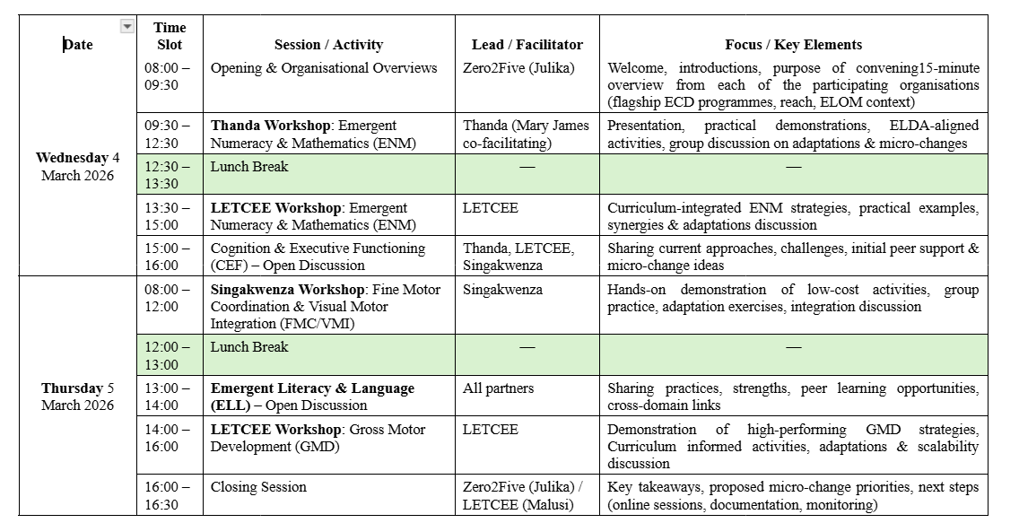
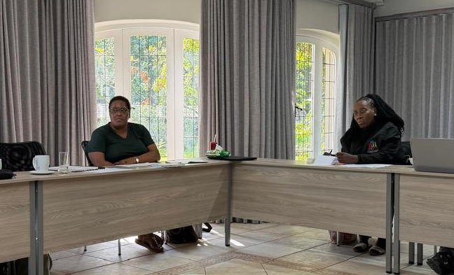
Identifying Micro-changes

Slide 13
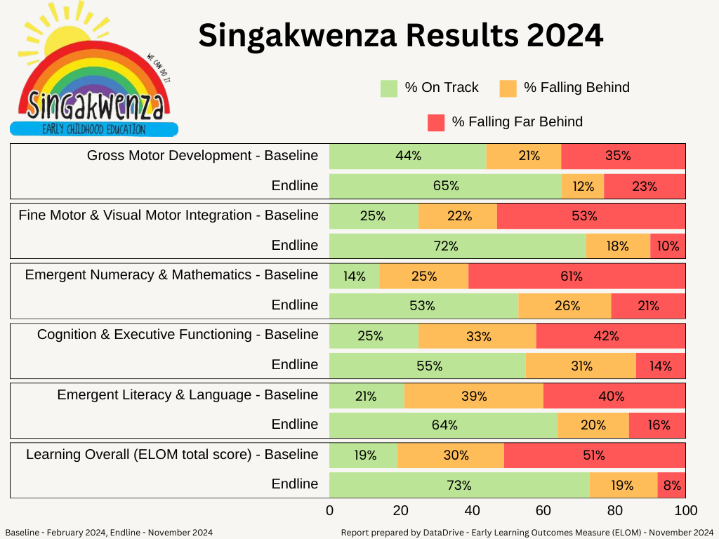

Slide 14
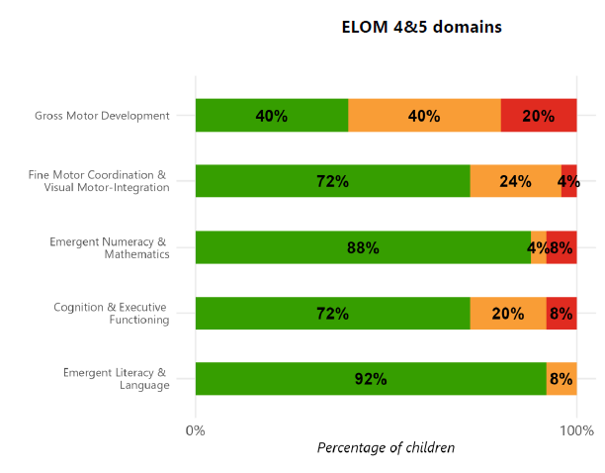

Slide 15
The Micro-Change Toolkit
A Practical Guide for Implementation

Slide 16
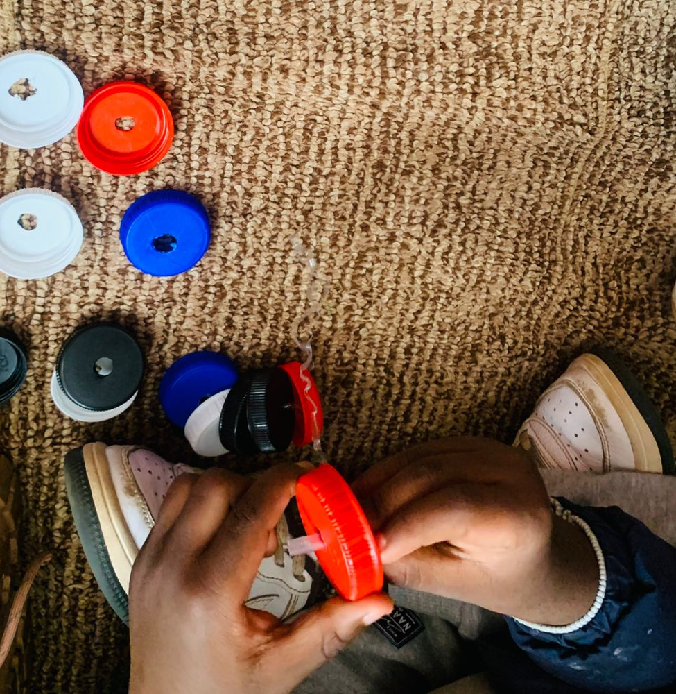
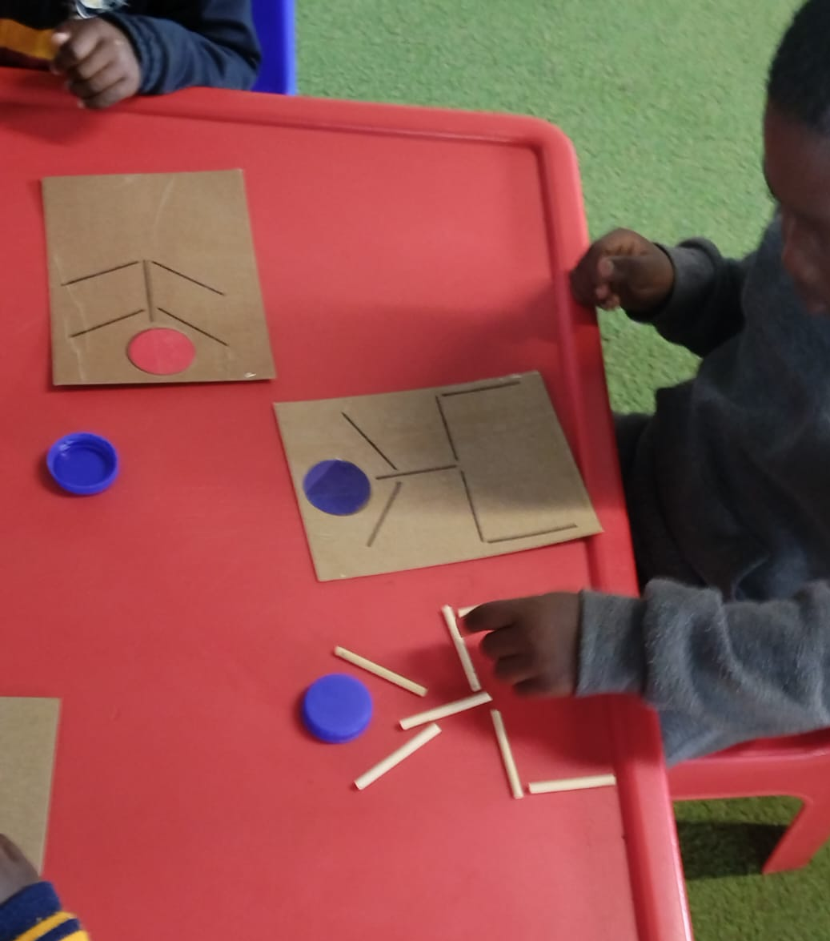
What fits under the FM-VMI domain?
Fine Motor Coordination
Visual Motor Integration

Slide 17
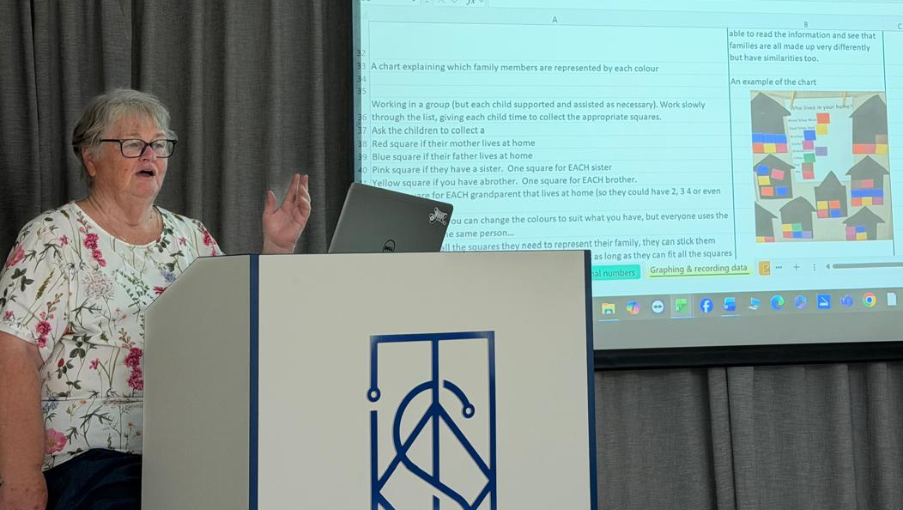
Numeracy - including throughout the day

Slide 18
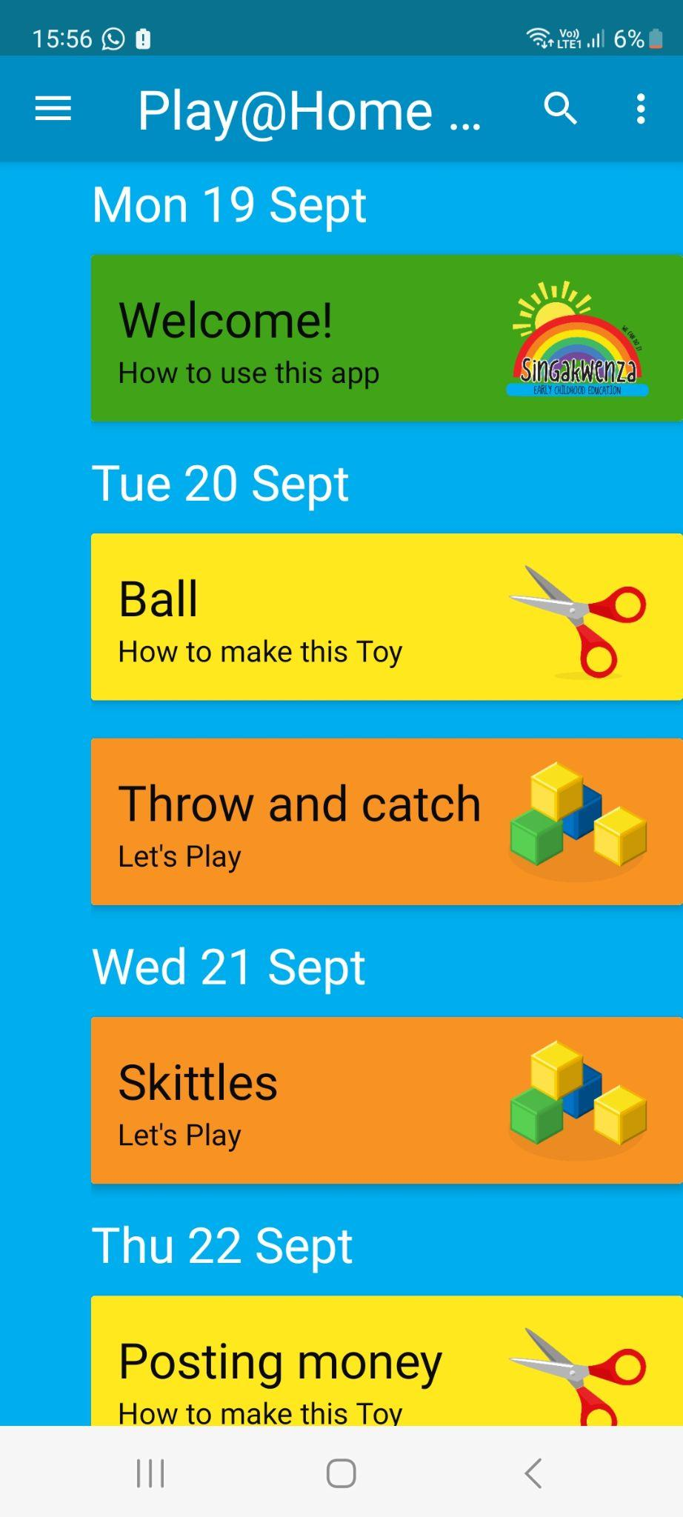

Toys made from Recycling from
the Play@Home with Singakwenza App

Slide 19

Development of the Toolkit

Slide 20
Training on the Toolkit
Training for Implementation

Slide 21
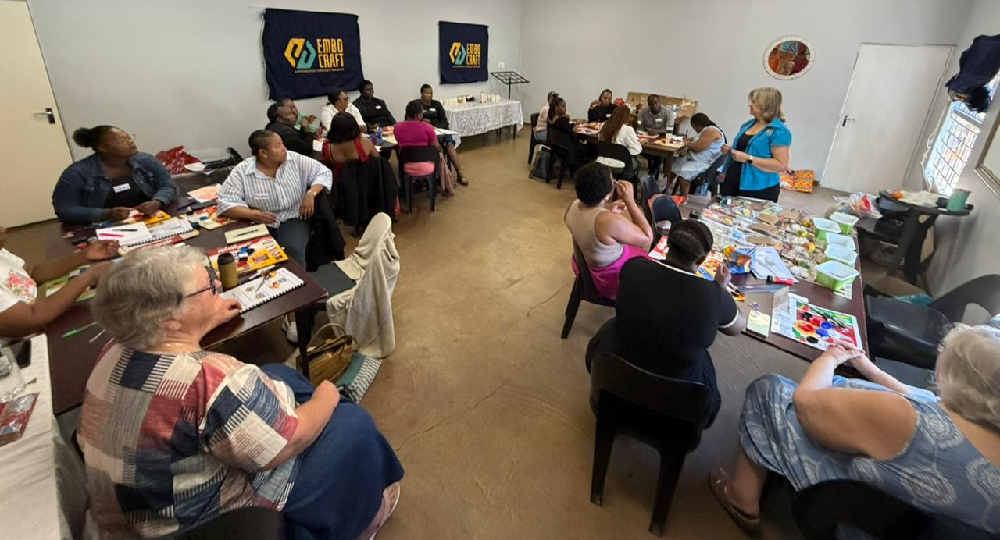
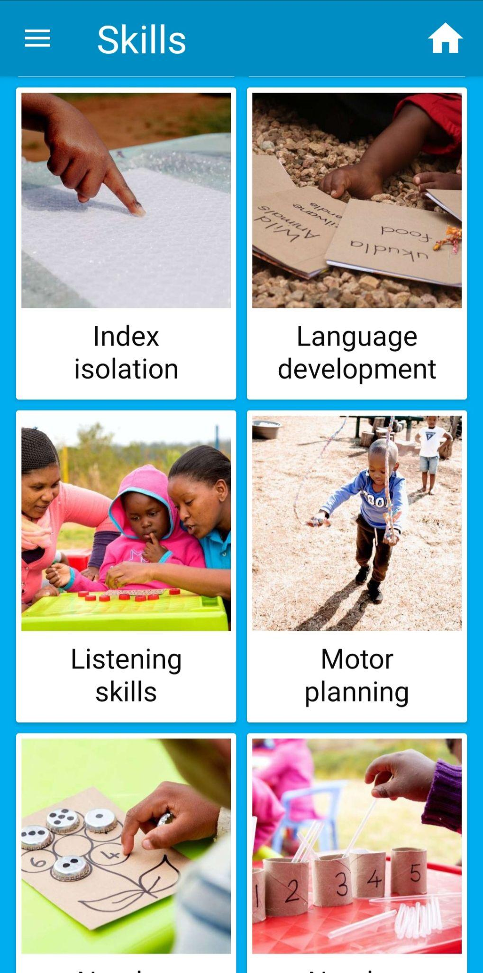
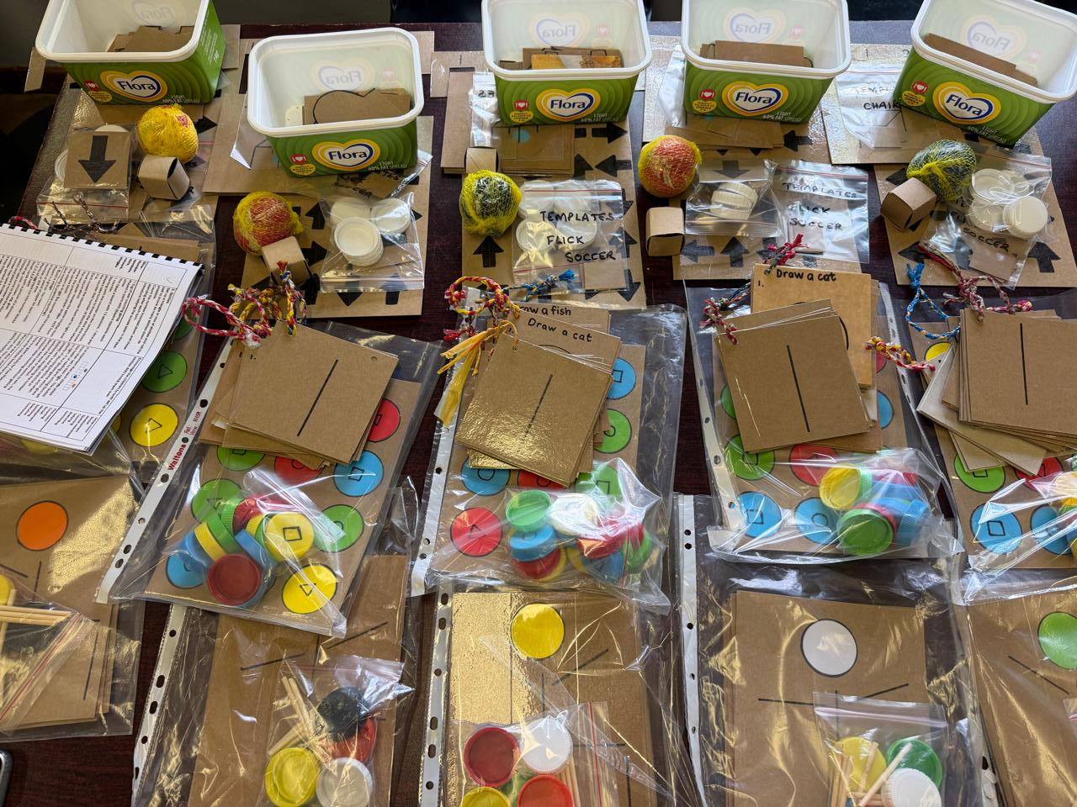
Training Trainers

Slide 22
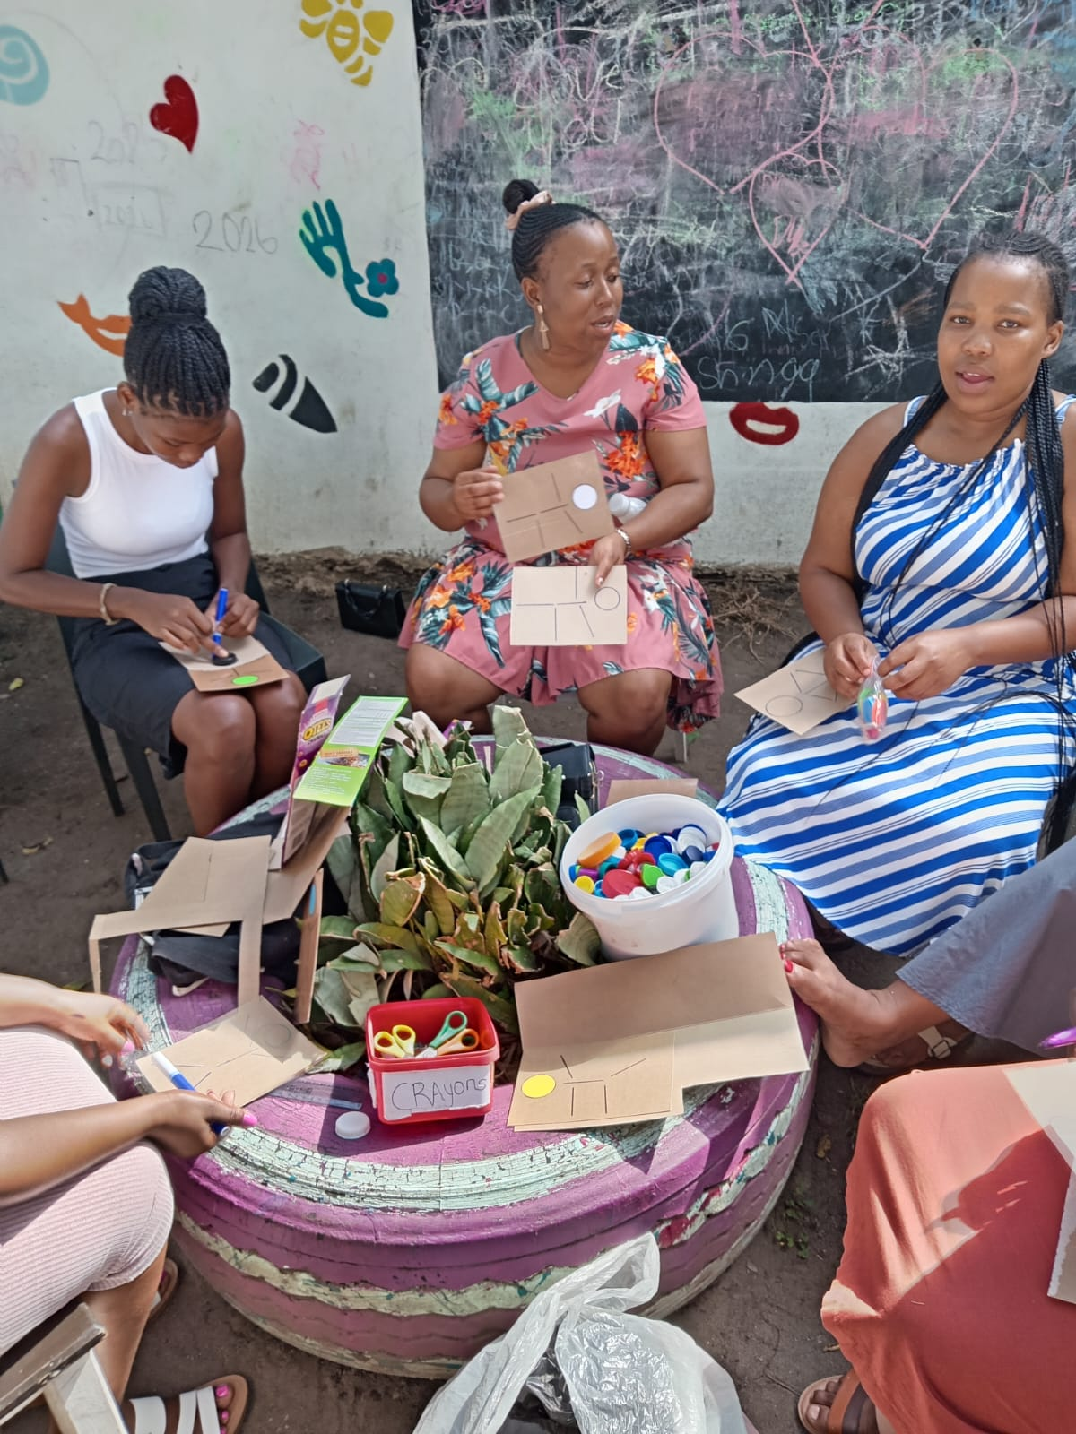
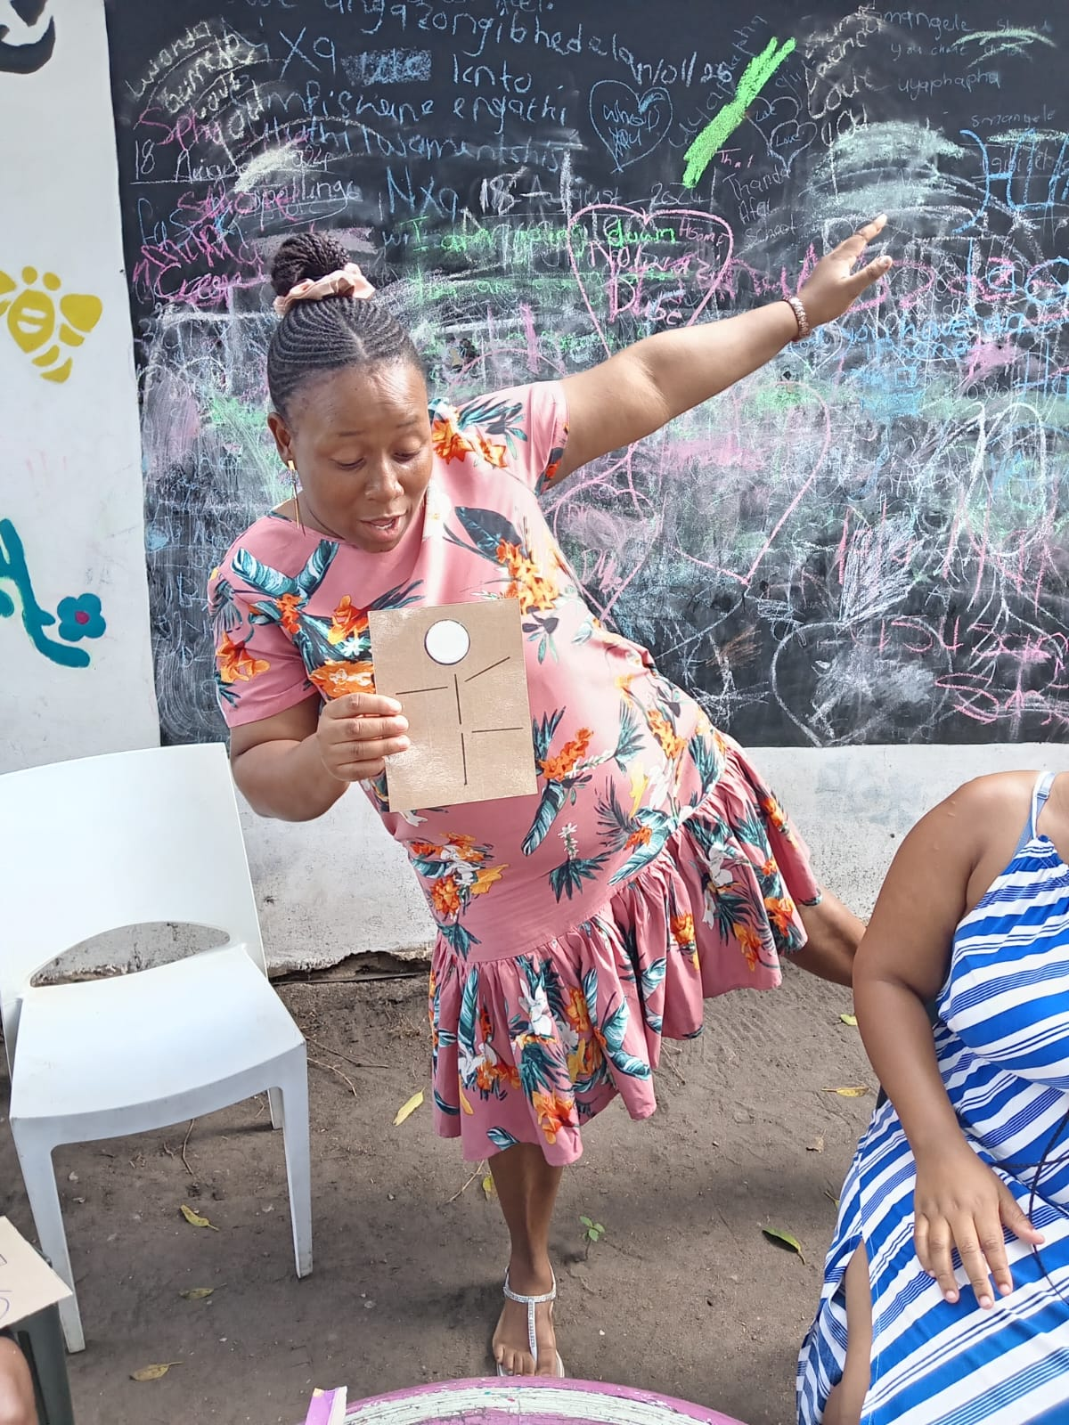
Training of ECD Practitioners
by Trainers

Slide 23
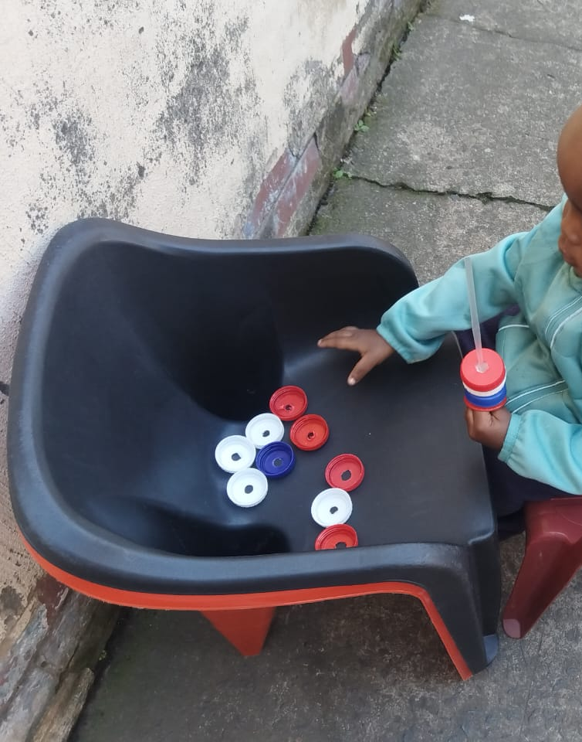
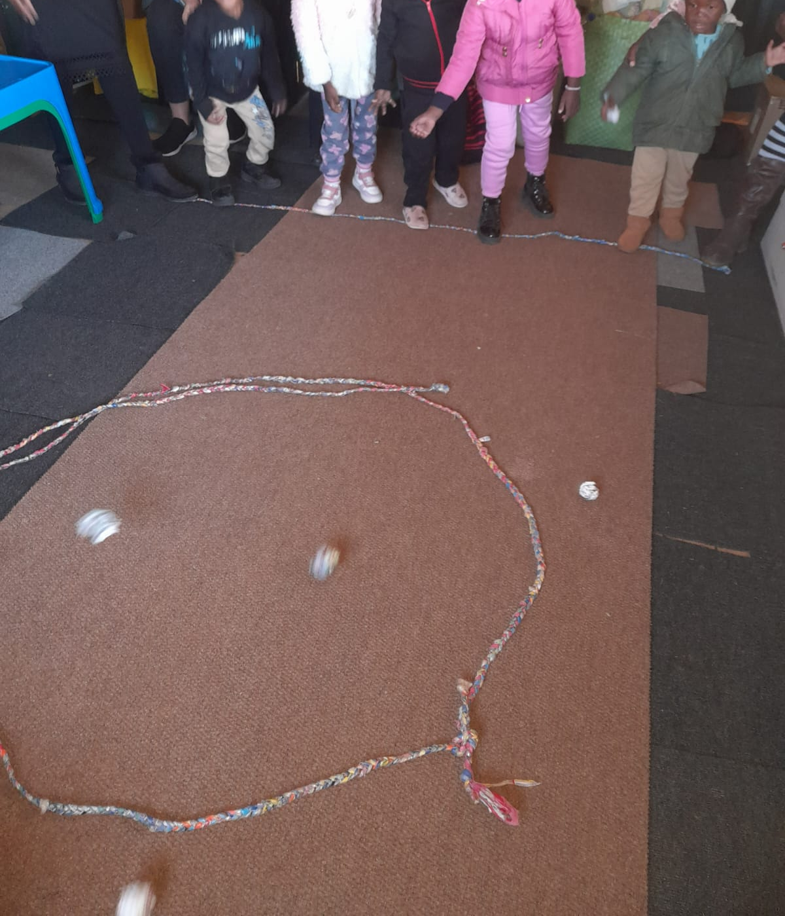
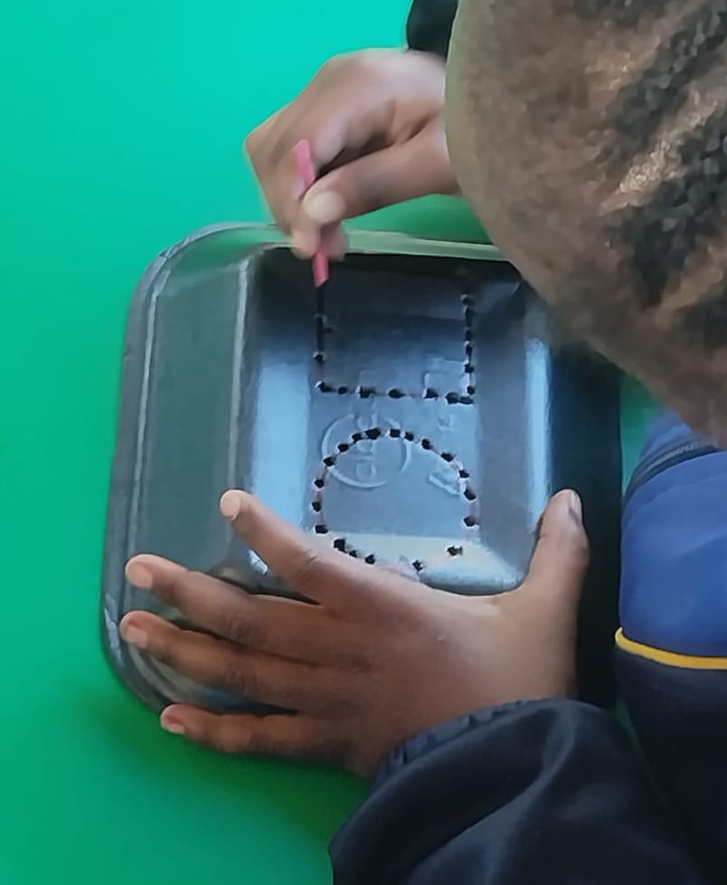
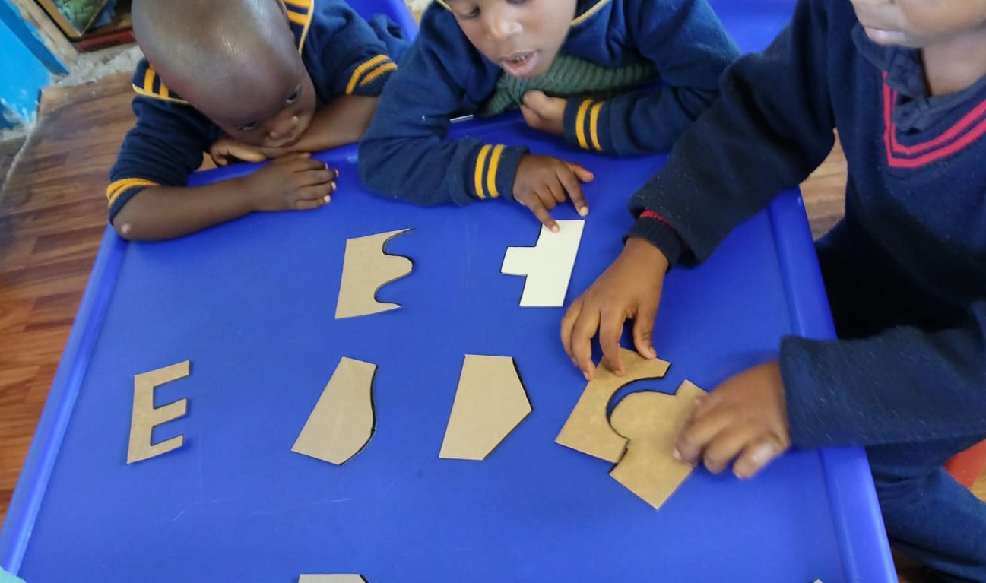
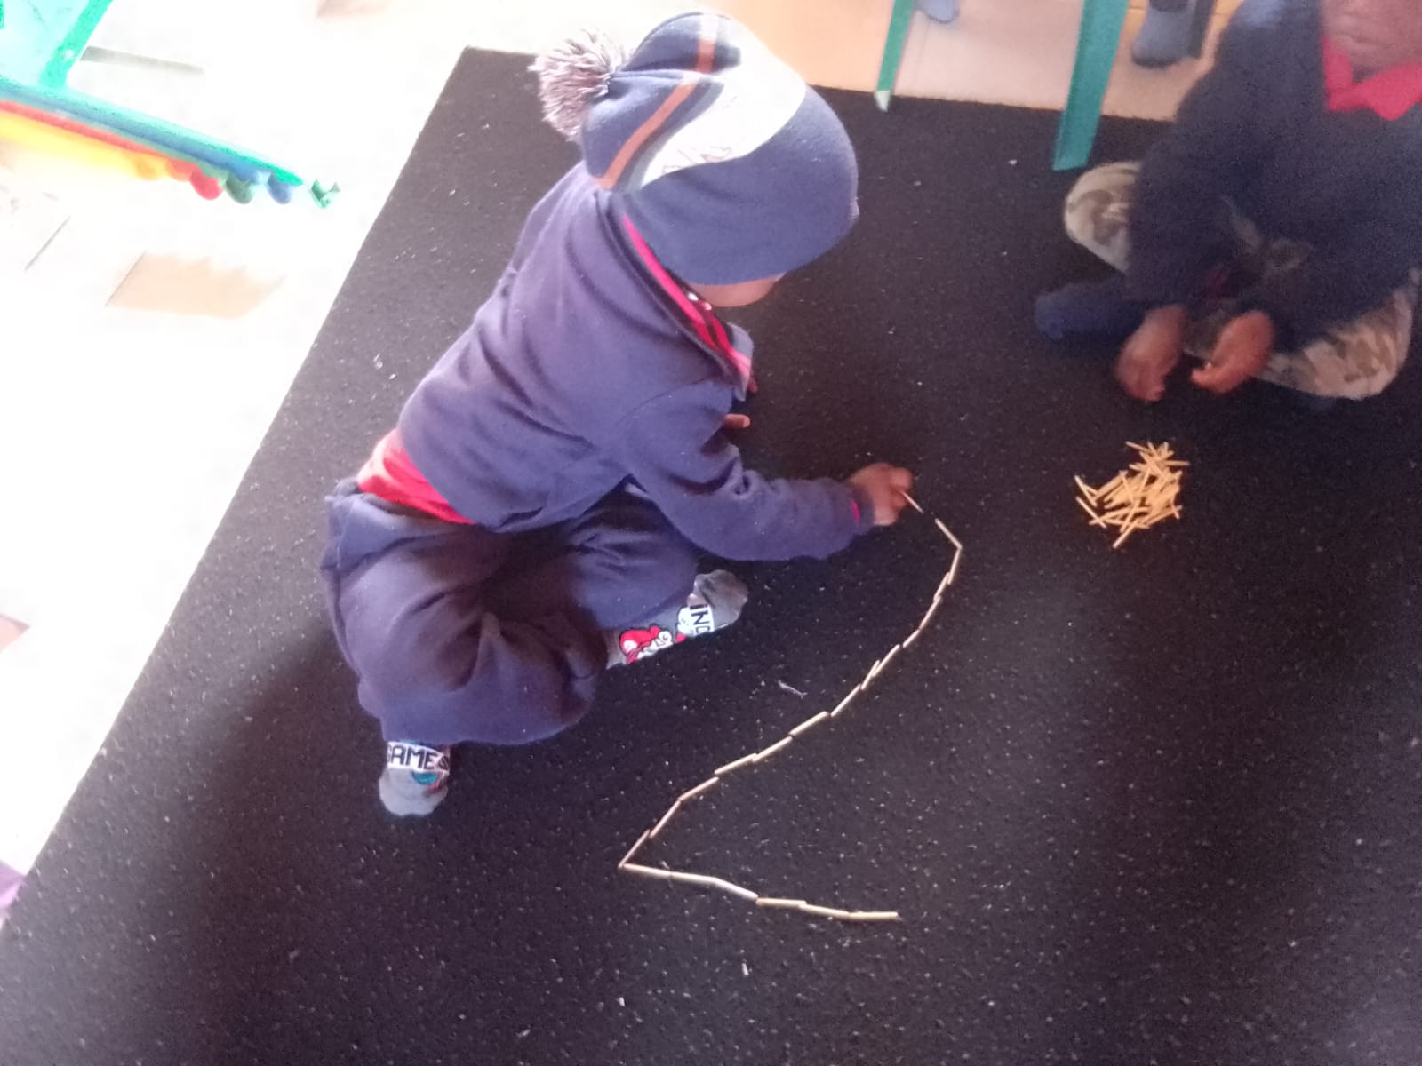
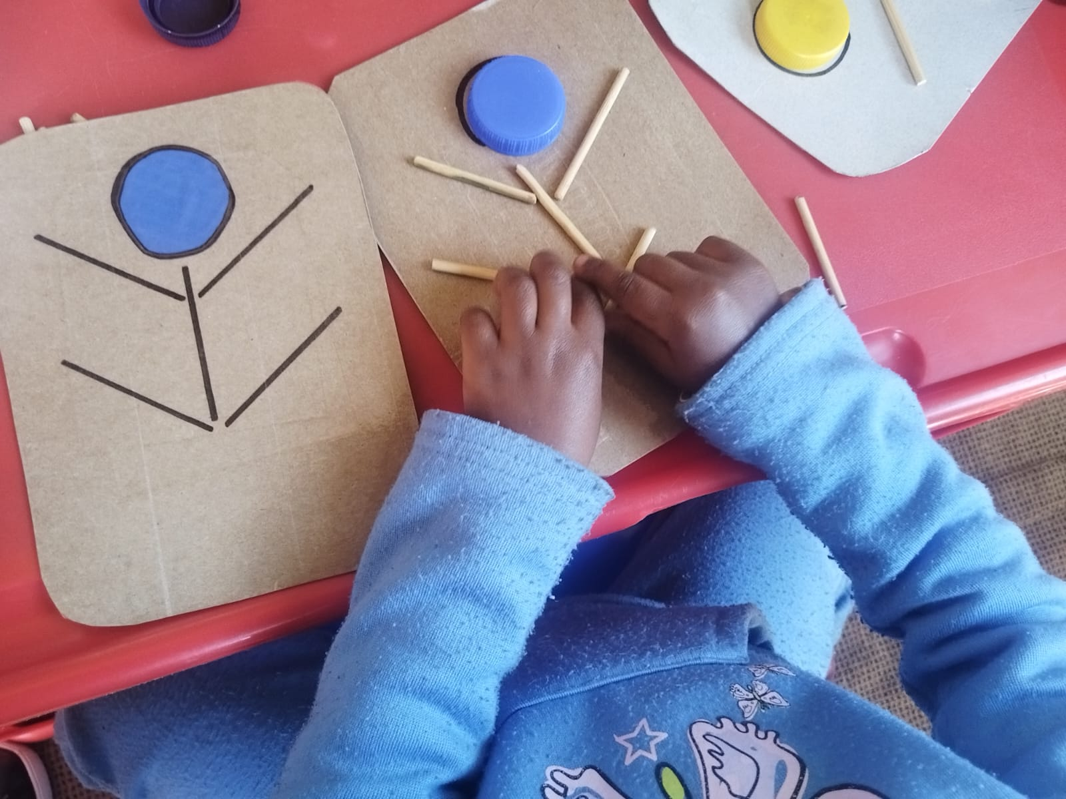
ECD Practitioners Implementation

Slide 24
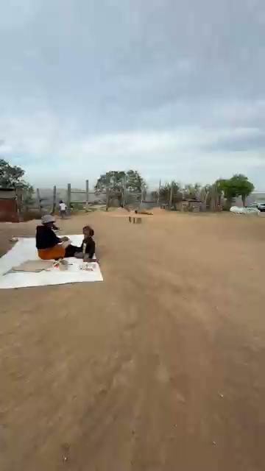
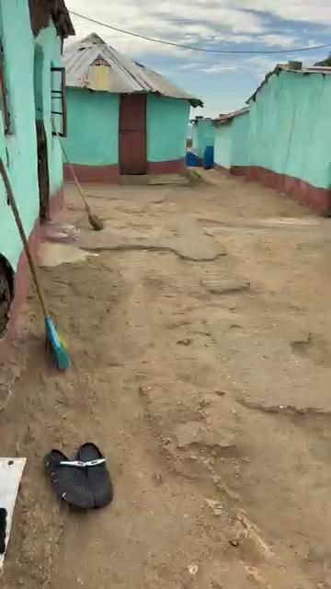
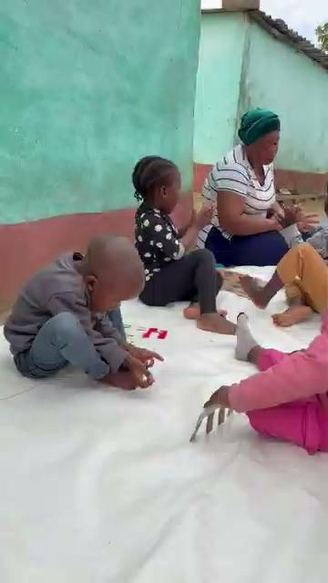

Slide 25
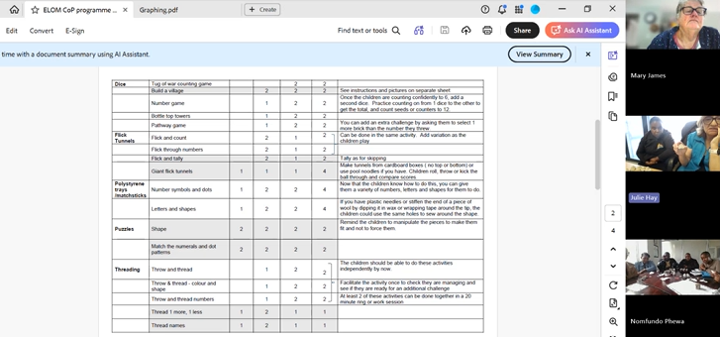
Monthly online Training and
Support for Trainers

Slide 26
Mentoring for Implementation
A Challenge & another Opportunity for Cross-Learning

Slide 27
74% of the children in pilot are in centres not directly run by our organisations.
How could we ensure they implemented the Toolkit?
How could we support them along the way to ensure quality implementation?
We realised mentoring was going to be the most direct lever for improving quality.

Slide 28

There was another opportunity for sharing & learning.
We once again looked within ourselves for the solution
and found it in Singakwenza’s approach to mentoring staff at
ECD Centres they don’t manage themselves.

Slide 29
Training & Mentoring structure
6 NPO Leads & 10 Programme Leads develop strategy together.
Build capacity of Training Mentors in each organisation through training & mentoring.
Ongoing training & mentoring for 131 ECD Practitioners within 76 ECD Centres/ Playgroups.
NPO Leads
Programme Leads
Child
ECD Practitioners
Training Mentors

Slide 30
Training & Mentoring structure
Design (training, mentoring, content sharing, resource making, check-ins, reminders, feasibility, feedback, accountability, adaptability) was based on learnings around successful mentoring on the ground.
Focus was on building trust and partnership as practitioners implement new activities — observing practice, giving feedback, and adjusting in real time.

Slide 31
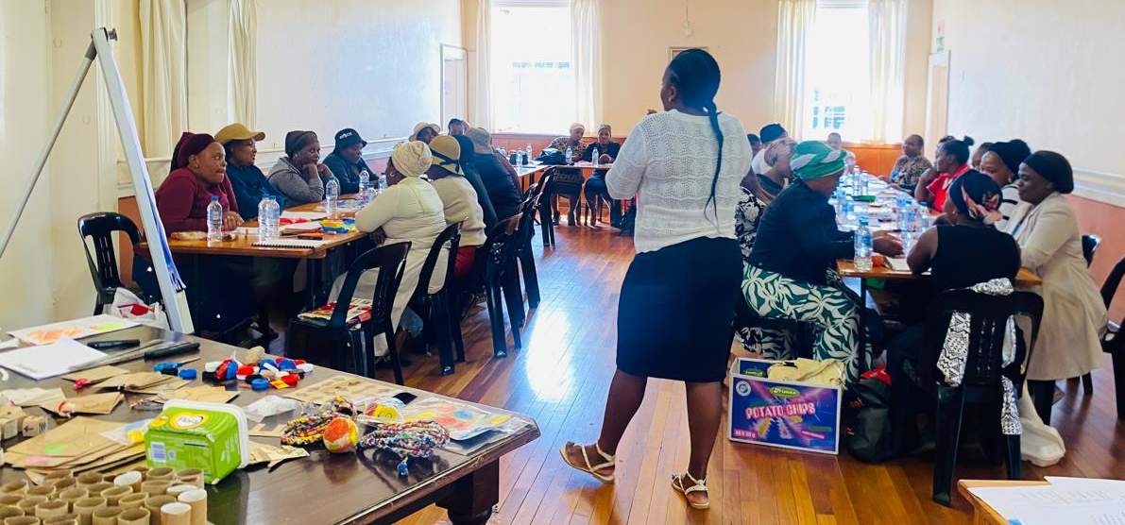
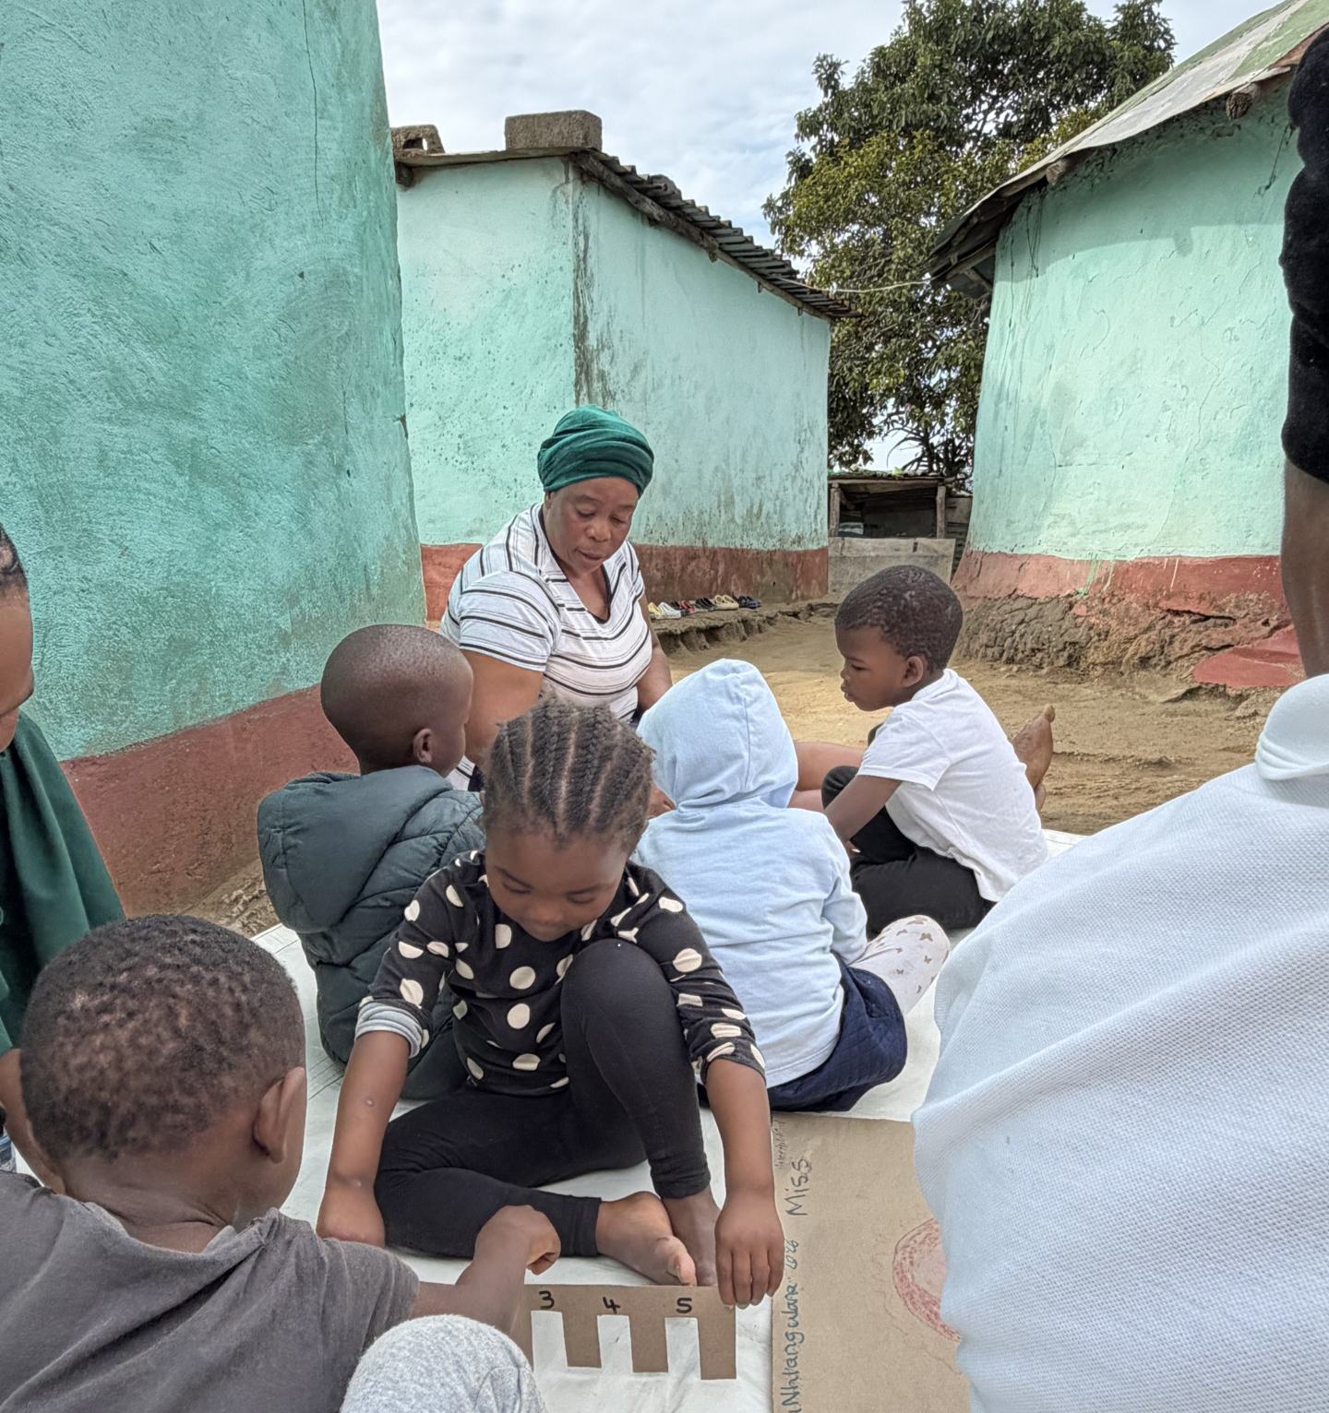
Training
AND
Mentoring

Slide 32
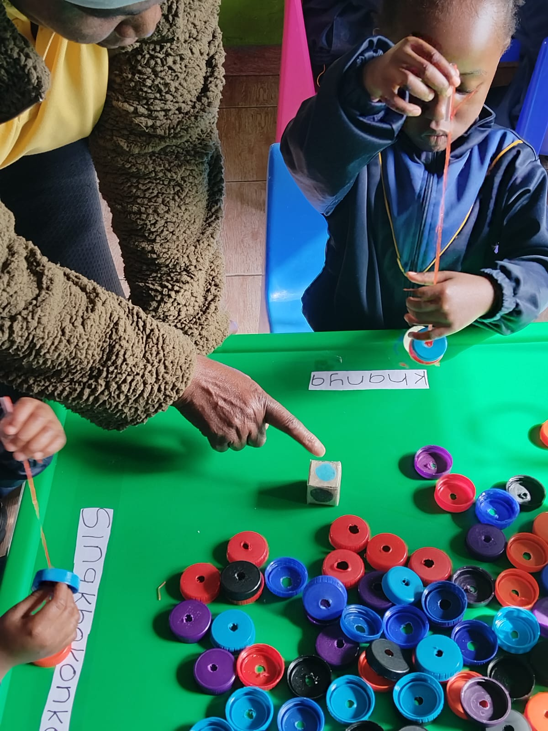
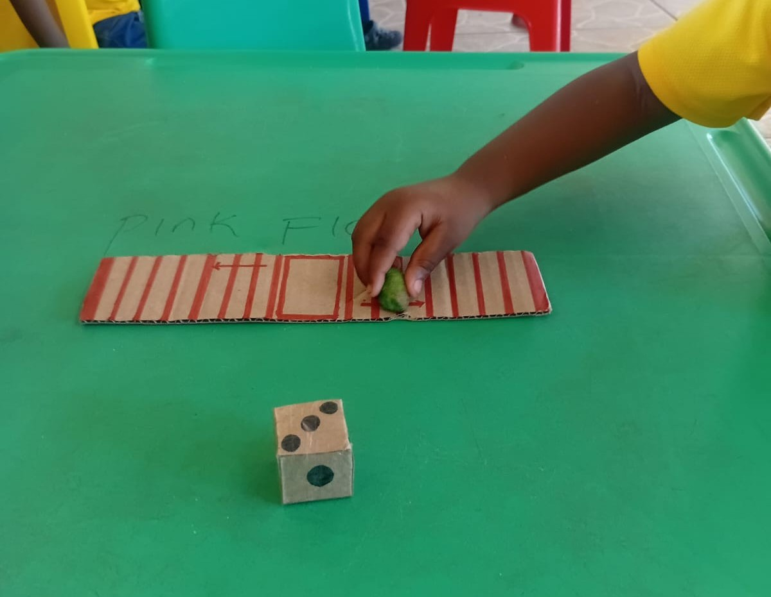
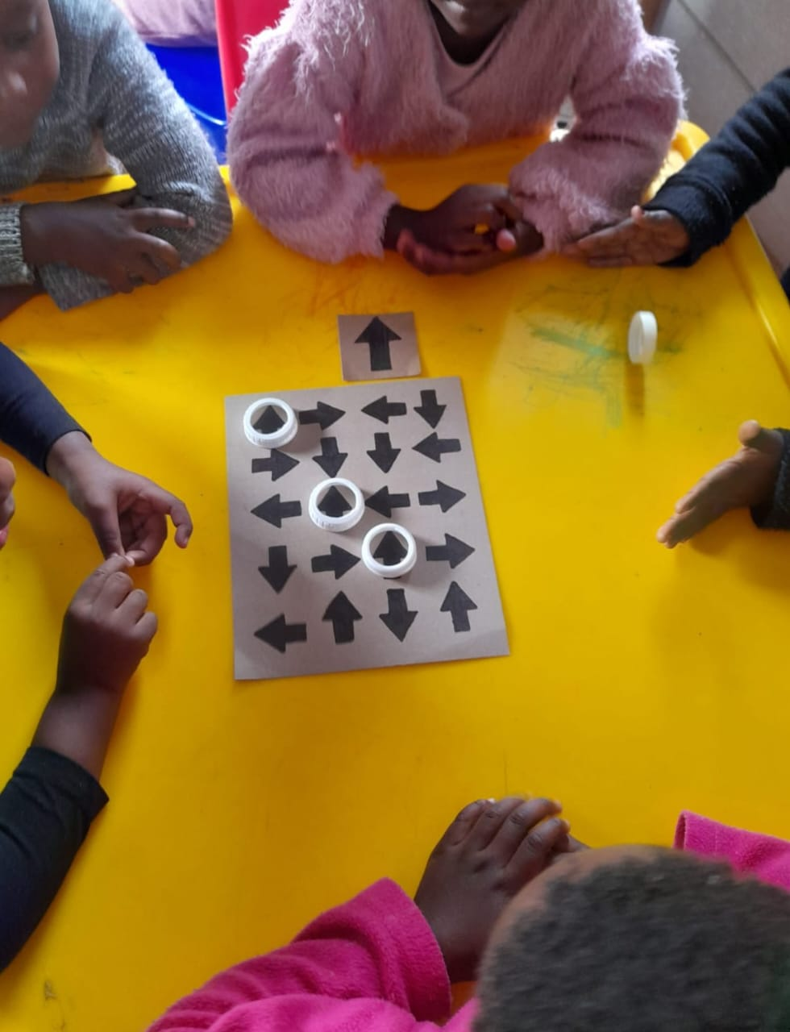
Cross-Organisational Mentoring
“From my observations the relationship between the practitioners and the facilitators came across as one of the most critical factors in achieving the intended results. The Singakwenza team appeared to be very intentional about building and maintaining strong working relationships with the practitioners. Upon arriving at the ECD centres there was no sense of policing or inspection observed, instead they blended in very well and became one with the practitioners, because of this the practitioners felt free to openly discuss gaps and areas where they are still struggling and in need of assistance.”

Slide 33
Monitoring, Evaluation, Research & Learning
Monitoring Progress & Impact over 20 weeks

Slide 34
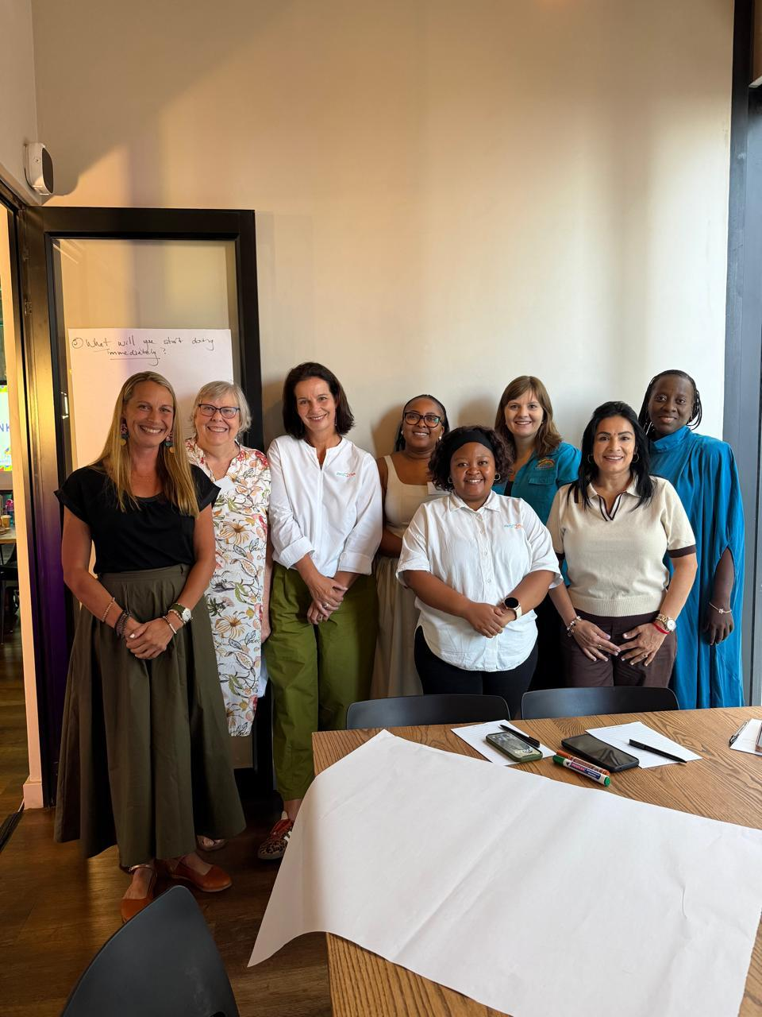
Can the following small, intentional programme shifts:
•intentional numeracy integration
•increased VMI exposure
•ECD practitioner mentoring
•low-cost play resources
•increased dosage
produce measurable improvements in ELOM
outcomes over time?

Slide 35
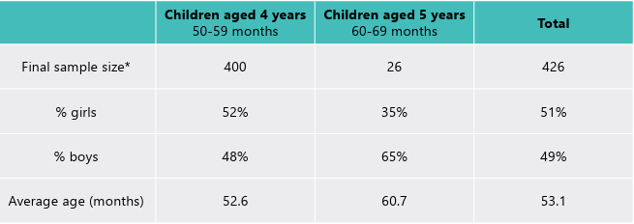
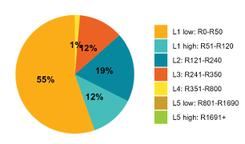
ELOM Baseline - February 2026

Slide 36
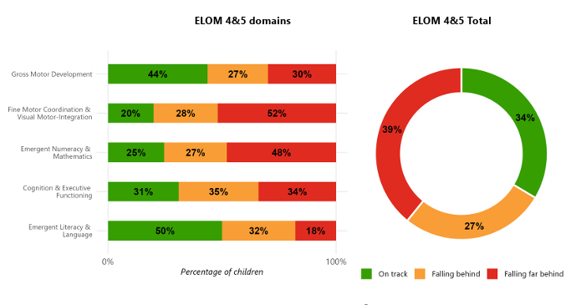

Slide 37
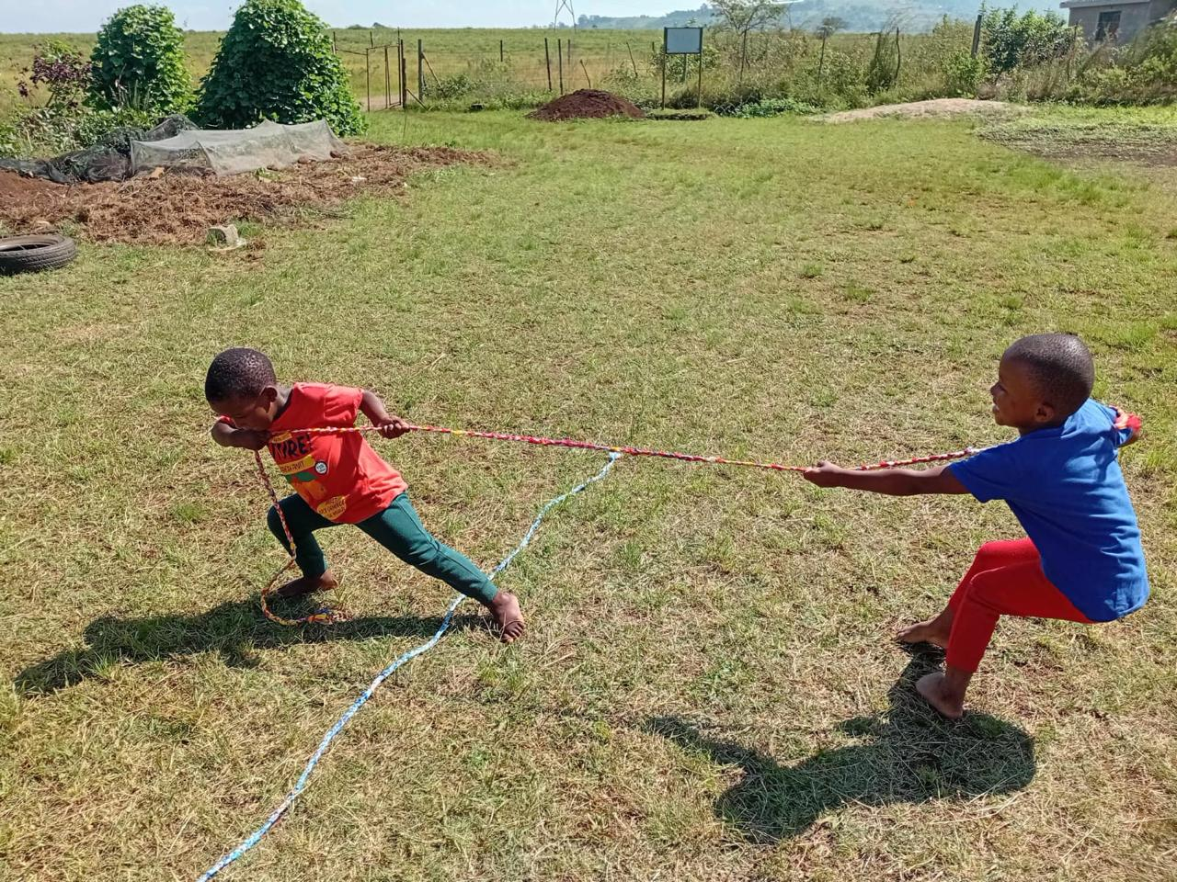
Cognition and Executive Functioning: Only 31% of children were on track (3rd weakest area).
Many of the VMI and numeracy activities also strengthen executive functioning.
Specifically, the activities around bilateral coordination, sorting, sequencing, crossing the midline, persistence and spatial awareness likely have ripple effects into CEF.

Slide 38
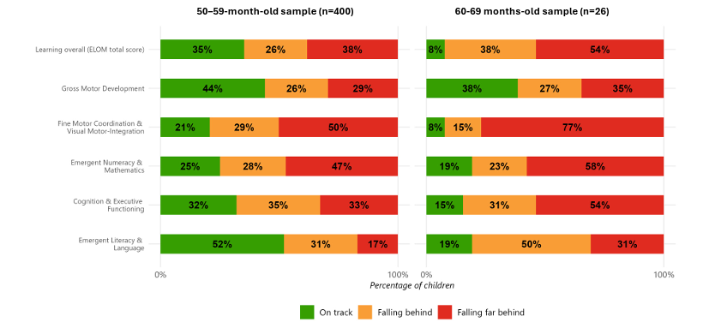

Slide 39
ELOM Child Outcomes Report: A chance to compare micro-change intervention against evidence of successful
practises nationally.
Weakest domains (VMI and numeracy) are:
highly practice-based
responsive to repeated exposure
dependent on active engagement
Broad curriculum reform is not necessarily the immediate need - targeted improvements in daily practice may produce meaningful gains.
Strong justification for:
recycled-material resource pack
scaffolded activities
facilitator coaching model
dosage tracking

Slide 40
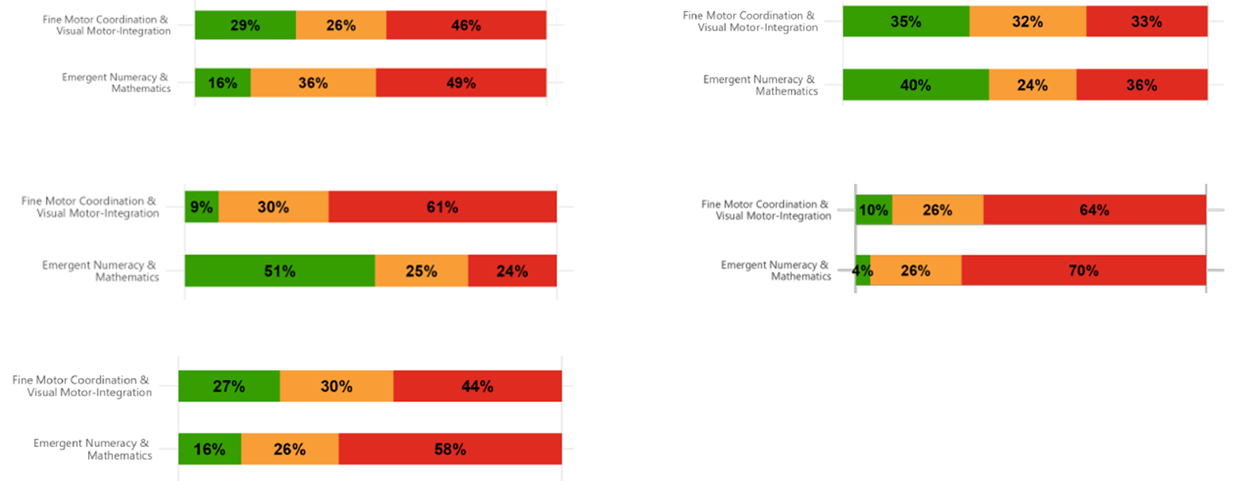
High standard deviation (13.3) reveals a wide spread in performance across different centers and practitioners. Strategically, this confirms that better outcomes are possible within rural KZN and supports the collaboration’s goal of "identifying micro-changes" from "pockets of excellence" and transferring them to weaker areas.

Slide 41
Not just "Did ELOM scores improve?"
But "What implementation conditions were associated with improvement?”

Slide 42
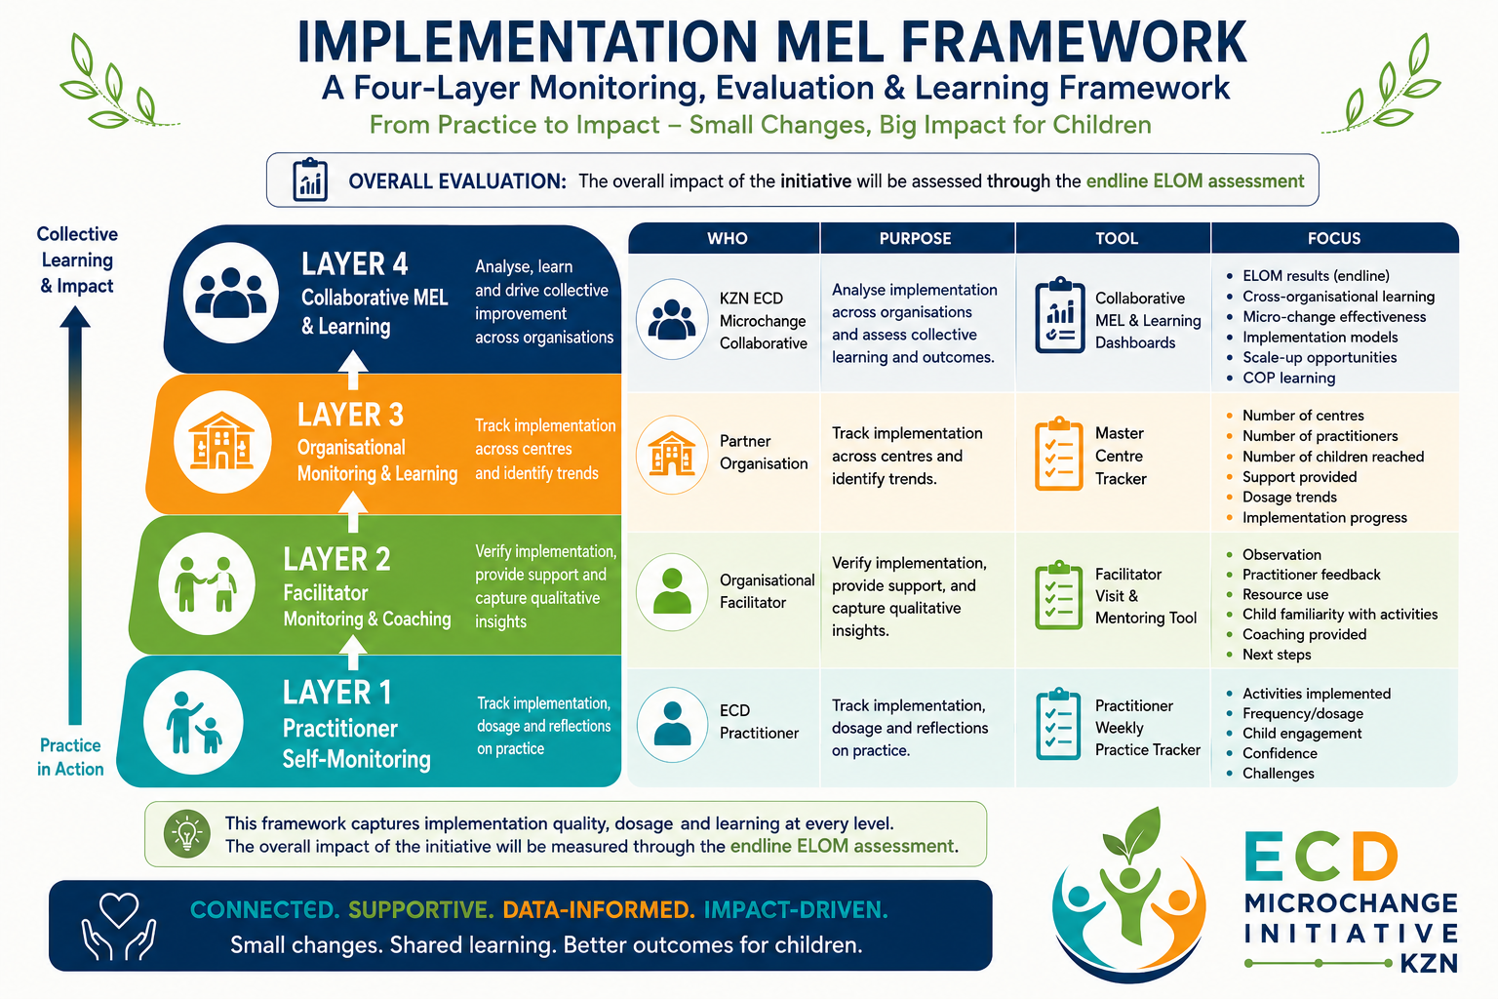

Slide 43
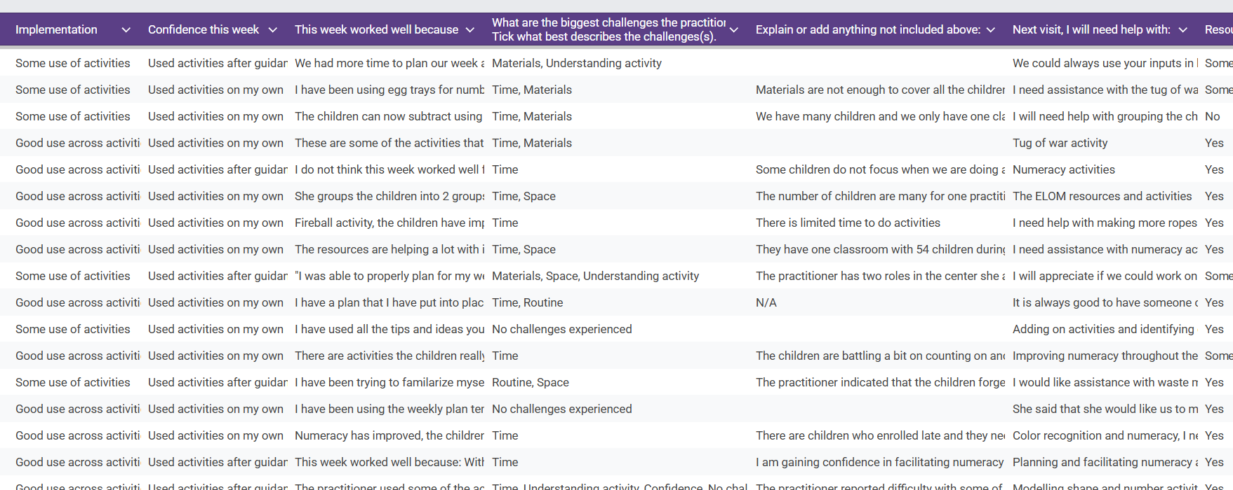
Not just implementing, but also:
documenting implementation
tracking dosage
comparing contextual variables
analysing mentoring processes
studying collaborative learning

Slide 44
A Multi-Layered Implementation Monitoring Framework
Layer 1: Practitioner Self-Monitoring
Who: ECD Practitioner
Purpose: Track implementation, dosage and reflections on practice.
Tool: Practitioner Weekly Practice Tracker
Focus:
Activities implemented
Frequency/dosage
Child engagement
Confidence
Challenges

Slide 45

Layer 2: Facilitator Monitoring and Coaching
Who: Training Mentor
Purpose: Verify implementation, provide support, and capture qualitative insights.
Tool: Facilitator Visit & Mentoring Tool
Focus:
Observation
Practitioner feedback
Resource use
Child familiarity with activities
Coaching provided
Next steps

Slide 46

Layer 3: Organisational Monitoring and Learning
Who: Partner Organisation
Purpose: Track implementation across centres and identify trends.
Tool: Master Centre Tracker
Focus:
Number of centres
Number of practitioners
Number of children reached
Support provided
Dosage trends
Implementation progress

Slide 47

Layer 4: Collaborative Monitoring, Evaluation and Learning (MEL)
Who: KZN ECD Microchange Collaborative
Purpose: Analyse implementation across organisations and assess collective learning and outcomes.
Focus:
ELOM results
Cross-organisational learning
Micro-change effectiveness
Implementation models
Scale-up opportunities
COP learning

Slide 48
Despite growing investment in ECD, there is insufficient evidence about which practical programme improvements directly shift child outcomes in rural KZN contexts.
Individual organisations lack the data volume and cross-contextual comparison needed to draw reliable conclusions. The ECD Microchange Collaborative KZN addresses this by bringing six organisations together under a single measurement framework, enabling comparisons that no single organisation could generate alone.

Slide 49
Preliminary Results
Monitoring

Slide 50
Example from the Practitioners: This week worked well because…
I have a plan that I have put into place that helps me be able to do all the activities with the children and even added on with some new ideas to some activities, I am having fun making the material and the children are also having fun using them.
I have used all the tips and ideas you usually share whenever you come for mentoring visits and it has helped me a great deal even for planning my week and daily routine.
Activities were implemented with support and learners were engaged during the sessions. There was improved participation when guidance was provided.

Slide 51
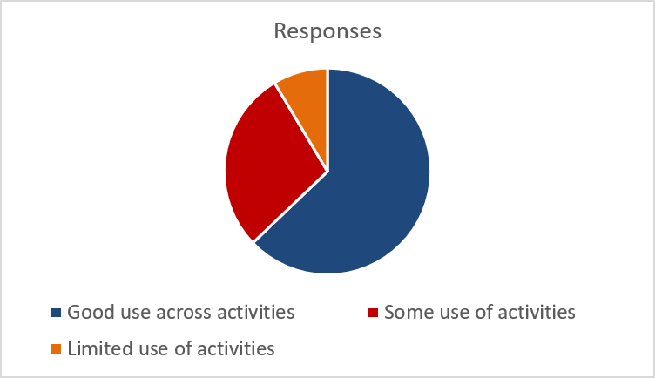
Biggest Challenges Practitioners have in implementing:
52% said time
21% said space
18% said confidence
33% said materials
Promising implementation- most things developing:

Slide 52
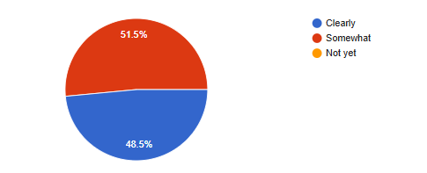
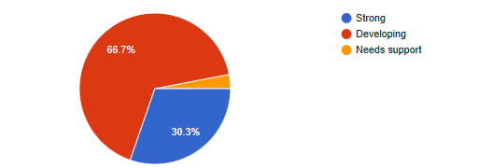
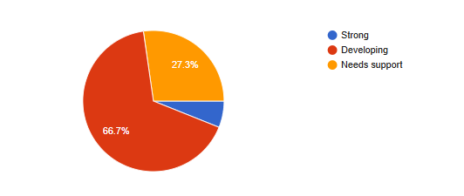
More defined activities are more easily implemented
Children are familiar with the activities
Confidence in Facilitation
Numeracy Throughout the Day

Slide 53
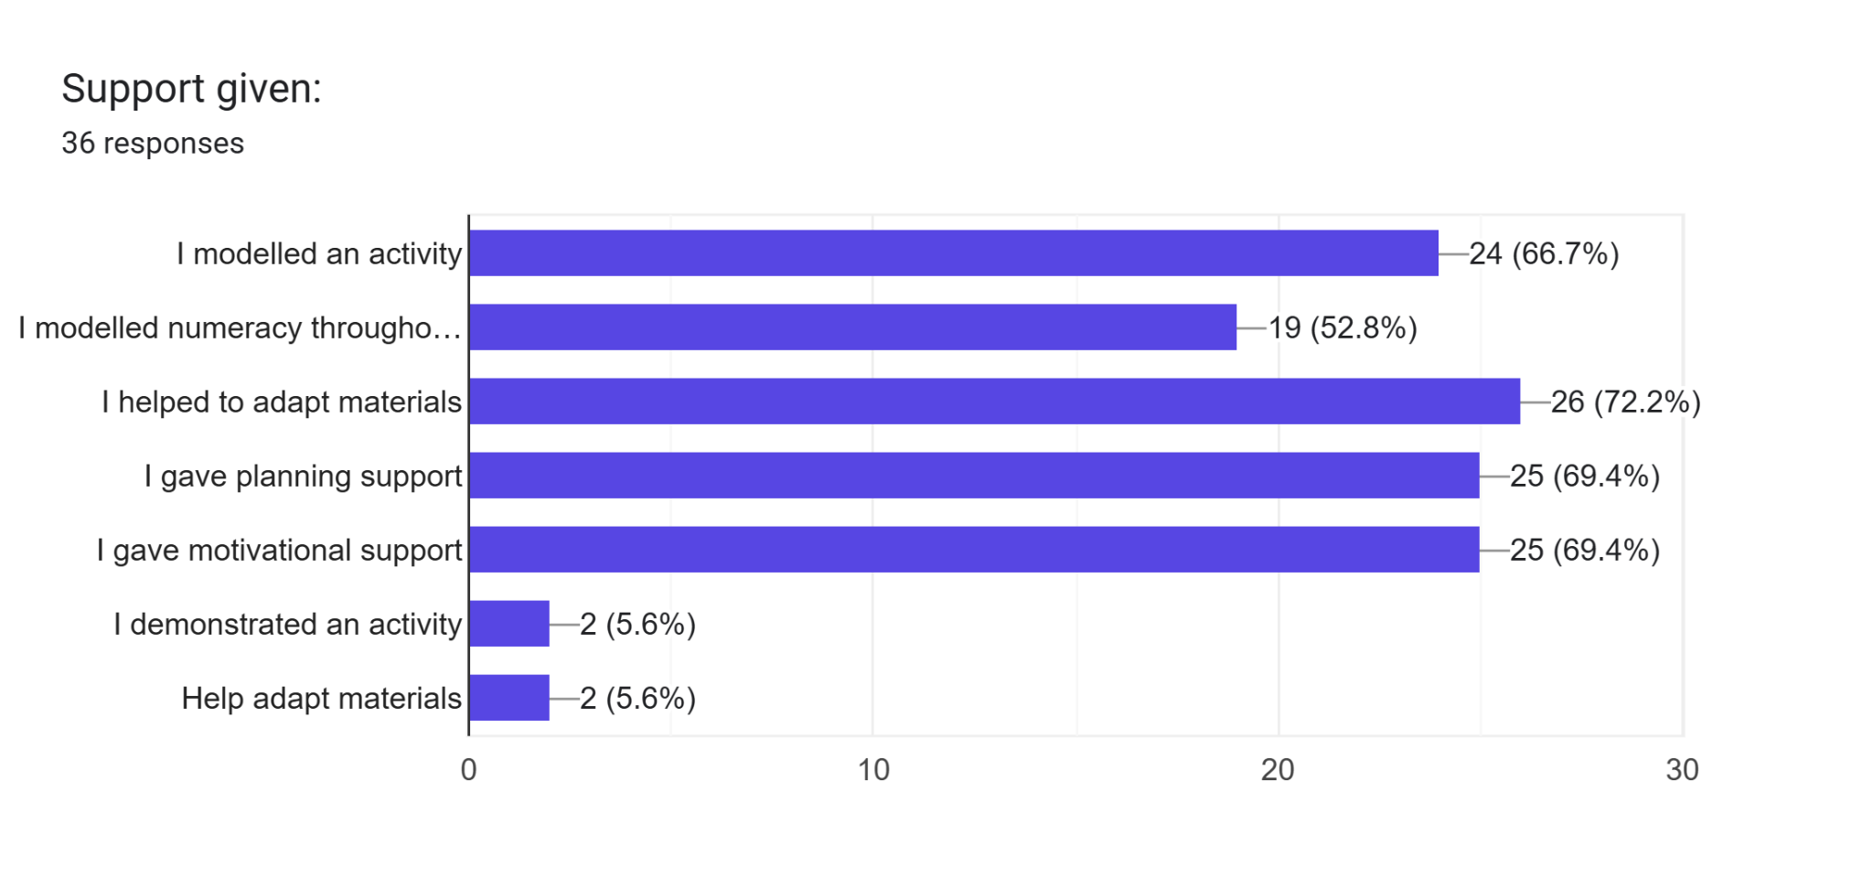
Role of mentoring (modelling)

Slide 54
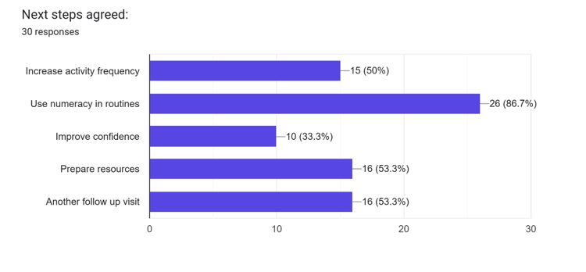
The importance of dosage is not well understood

Slide 55
Example Observation by the Training Mentor:
The practitioner is beginning to integrate numeracy during structured activities and some informal moments, such as counting, sorting, and simple comparisons during lesson time. There is growing awareness of using numeracy beyond planned activities, but this is still developing.
Due to the large number of children, numeracy activities were not consistently integrated throughout the day. Support is needed to include simple counting and number concepts during daily routines.
The practitioner integrated numeracy throughout the day by encouraging children to count objects during play, identify numbers in the classroom environment, and participate in sorting and matching activities. Available resources were used to support learning, and children were actively engaged throughout the activities. The practitioner showed growing confidence in facilitating numeracy experiences and responded positively to guidance and mentoring provided during the visit.
The practitioner has an understanding of how she could plan and what she could do with her children every day, she was able to integrate both Funda Engadini and ELOM activities such as the threading activities integrated with the theme of the week
Another Observation by the Training Mentor:
There was a lot of positive improvement from the practitioner, taking from the training session and support visit she had had. She is determined to learn and improve her facilitating and teaching skills.

Slide 56
Sustainability: Additional Outcomes
Building capacity of ECD Practitioners
Increasing attention that ECD Practitioners pay to each child’s individual progress
Expanding awareness of time for learning in ECD day
Building trust between ECD Practitioners and NPO
Readily available resources in all areas of the country

Slide 57
Conclusion

Slide 58
Despite growing investment in ECD, there is insufficient rigorous evidence about which low-cost, practical programme improvements shift child outcomes in under-resourced rural contexts. The ECD Micro-change Collaborative KZN aims to address this gap directly.
When multiple ECD organisations systematically share data, test practical micro-changes in their programmes, and reflect on what works across different contexts, they generate credible evidence that improves practitioner quality and child outcomes - and that can inform sector-wide practice.
The ECD Micro-change Collaborative KZN is positioned to demonstrate - with real data, across diverse programme contexts - which low-cost early learning interventions move the needle on child outcomes.

