Slide 1

FINDING THE CHILDREN WE MIGHT MISS: LESSONS FROM SIYAKWAZI’S ELOM TT PILOT
Presenter name: Cathy Mather-Pike
Organisation: Siyakwazi NPO

Slide 2


FINDING THE CHILDREN WE MIGHT MISS
Lessons from Siyakwazi’s ELOM Targeting Tool pilot
Exploring how different screening tools can strengthen early identification and help children access the support they need.

Slide 3
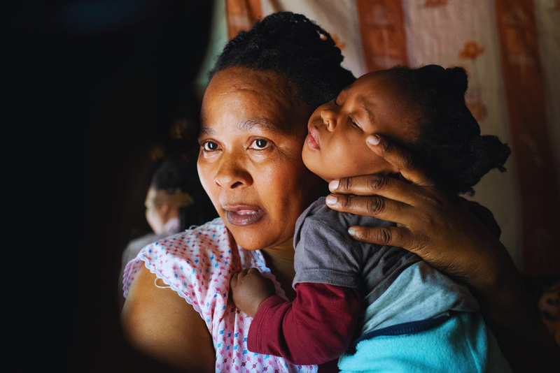
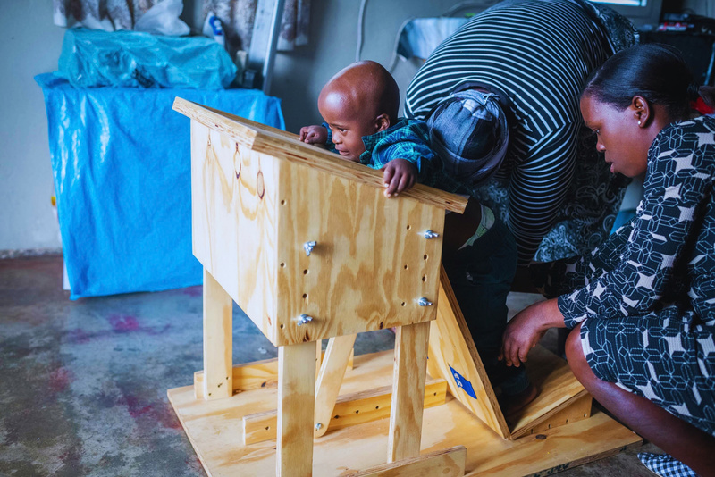
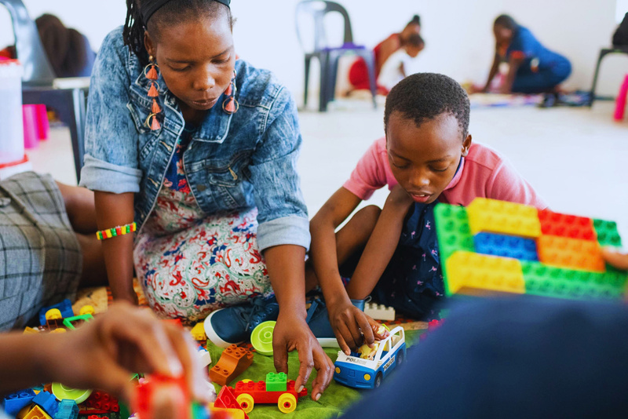
AN OVERVIEW OF SIYAKWAZI
  Community-based organisation founded in 2013 working in rural KwaZulu-Natal, supporting 1,300+ beneficiaries.
  Supporting children with disabilities and barriers to learning from birth to seven years.
  Working alongside guardians, ECD practitioners and schools to identify children’s needs and improve access to support.
  Using early identification, developmental screenings / assessments and targeted intervention to help children participate and learn.
  Programmes:
    Inclusion Programme (including Respite Play & Learn and Inclusive ECD Hubs expansion)
    School Readiness Programme
    Early Learning Programme (0-2 years)
1 in 10 children has a disability (UNICEF, 2021).
Children with disabilities are 25% less likely to attend early childhood education
(UNICEF, 2021).
Half a million children with disabilities have been shut out of SA’s education system (Angie Motshekga,
Minister of Basic Education SA, 2018).

Slide 4
WHY FOCUS ON EARLY IDENTIFICATION?
We cannot support a child we don’t know.
Developmental difficulties can go unnoticed, particularly when they are not immediately visible or are mistaken for differences in the pace of development.
Our question:
  Could piloting the ELOM Targeting Tool alongside our existing Red Flag process help us identify more children, identify them earlier, or better understand their needs?
Siyakwazi’s Red Flag Tool
  Observation-based screening conducted by Siyakwazi Siyasizas.
  Nine simple tasks covering motor skills, language, emergent numeracy and following instructions.
  Children identified as at risk of falling behind supported through catch-up groups.
ELOM Targeting Tool (ELOM TT)
  Activity-based screening for children aged four and five.
  Five activities covering skills such as language, counting, drawing and motor coordination.
  Identifies children at risk of falling far behind their peers.
The aim was not to replace one tool with another, but to explore what we could learn by using both.

Slide 5
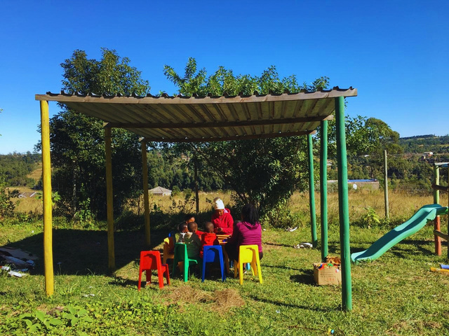
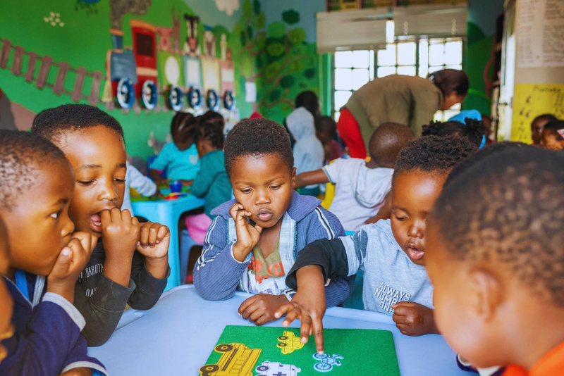
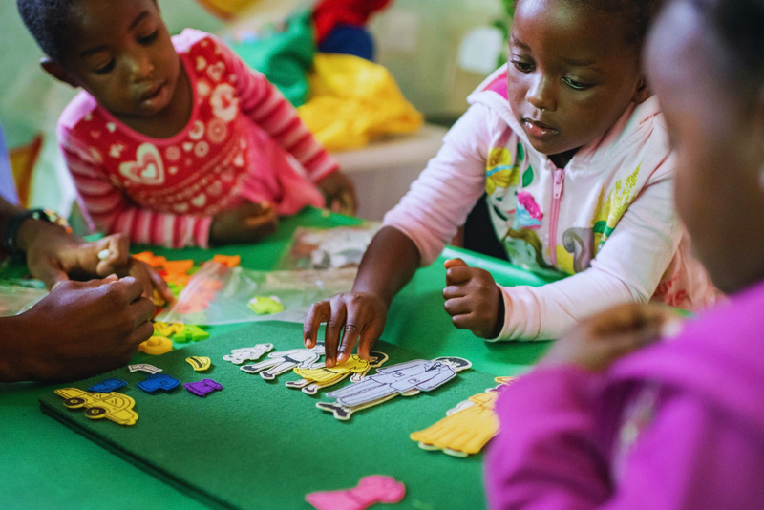
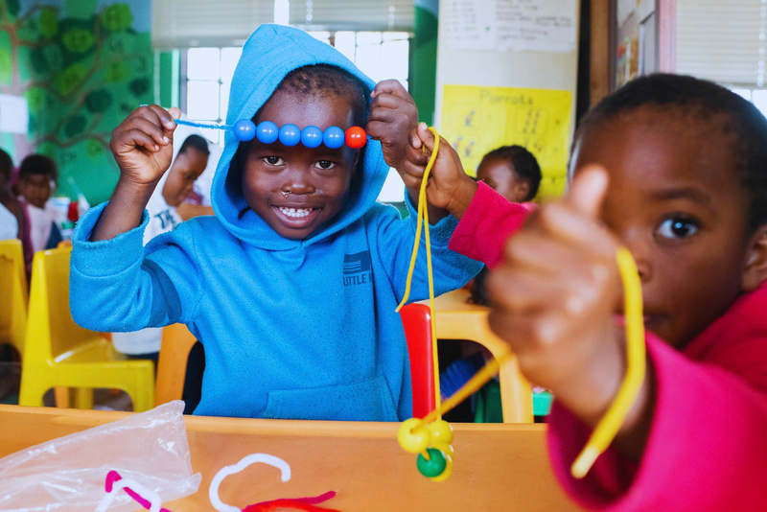
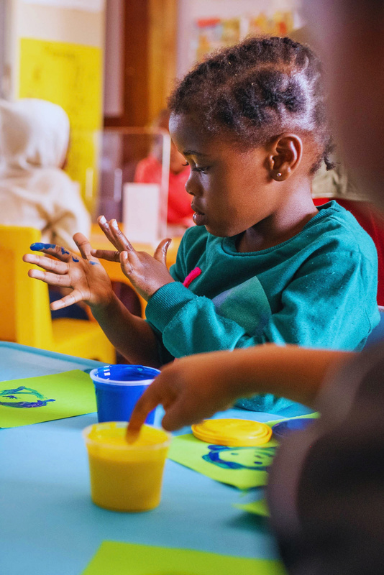
THE PILOT: ELOM TT ALONGSIDE RED FLAG
16 Siyakwazi-supported ECD centres
  ELOM TT piloted in March and April, following the usual Red Flag screening.
  101 children initially assessed.
  95 children included in the ELOM TT analysis.
  Results compared with Siyakwazi’s existing Red Flag records.
We wanted to understand where the tools identified the same children, where they differed and what this could tell us about our early identification process.

Slide 6
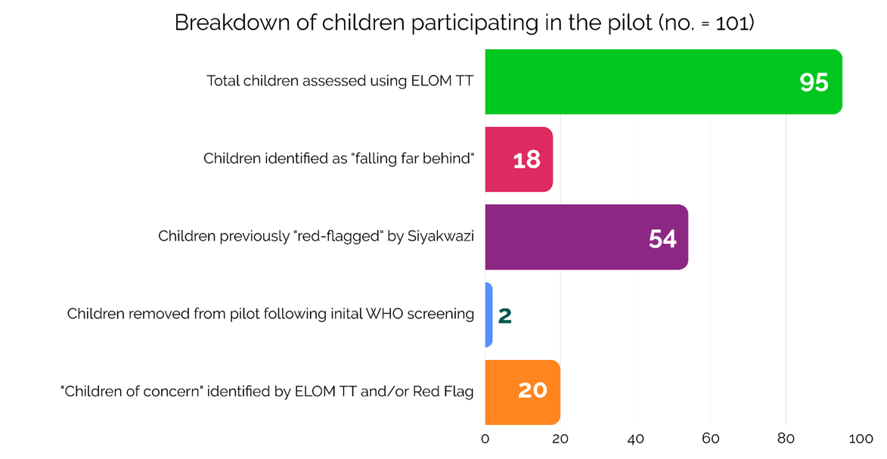

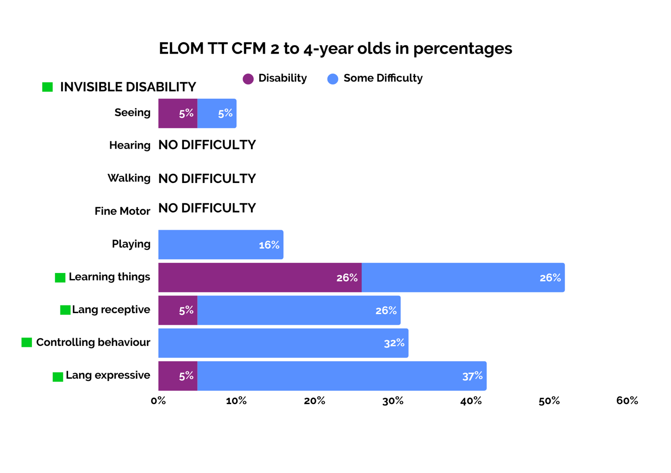
WHO DID THE SCREENING IDENTIFY?
95 children assessed:
  18 children (19%) identified by ELOM TT as falling far behind.
  54 children had already been identified through Red Flag.
  2 additional children were identified through routine WHO disability screening conducted by ELOM assessors.
20 children of concern were included in the next stage of assessment and follow-up (CFM screening). More on slide 8.

Slide 7
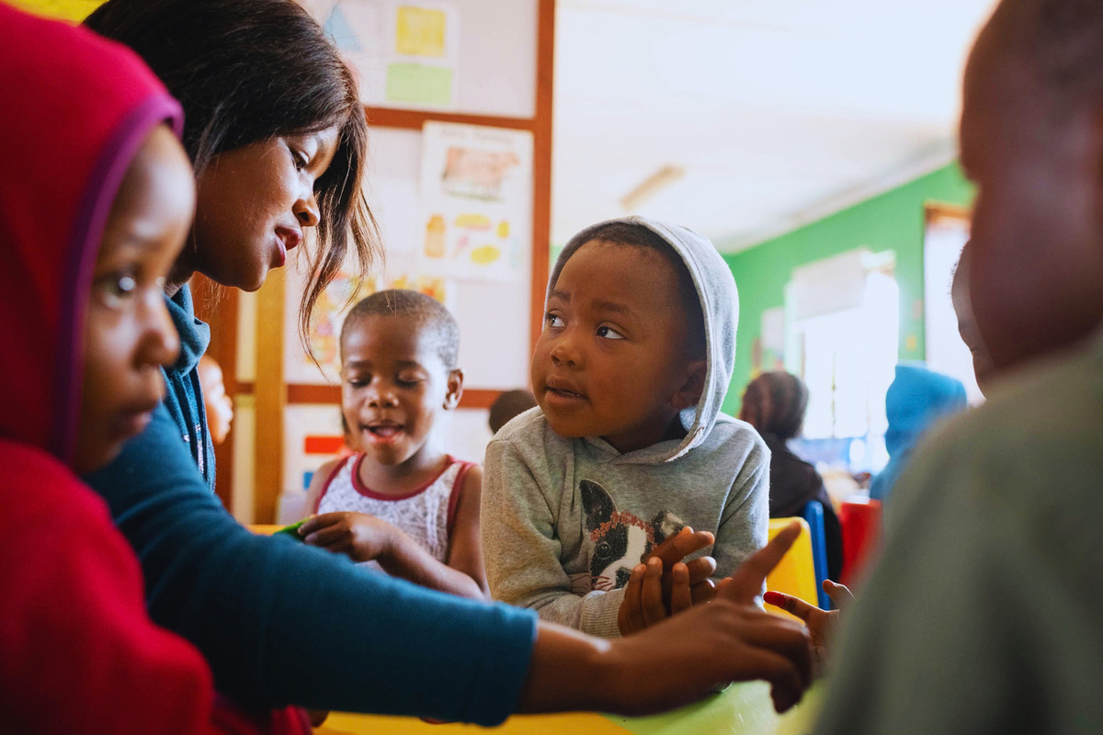
WHO MIGHT WE HAVE MISSED?
Of the 20 children of concern:
  16 children (80%) had already been identified through Red Flag.
  4 children (20%) had not been Red Flagged earlier in the year.
  4 children (20%) were already receiving support through Siyakwazi’s Inclusion Programme.
The overlap between the tools was substantial, but ELOM TT also identified children who had not been picked up through the existing process. In addition, the tool provided a smaller group of children with potential significant delays.
  Key question: What are we learning from using both tools that will ultimately support us to strengthen early identification in Pre-Grade R?
Screening is only the starting point:
Identifying a child who may need support does not tell us exactly what that support should be. We need to build a clearer picture of each child’s development, strengths and difficulties.
Our follow-up process:
  Initial screening through ELOM TT and Red Flag.
  UNICEF Child Functioning Module (CFM).
  Further developmental assessment using ASQ-3, where indicated.
  Individual goals and targeted support informed by assessment findings.

Slide 8

Follow-up:
Step 1
WHAT DID CFM TELL US?
Identifies functional difficulties among children aged 2–17 years w/ parent/caregiver questionnaire.
All 20 children of concern completed the Child Functioning Module.
The most prevalent areas of reported difficulty were:
  Learning
  Communication
  Behaviour
These difficulties are not always immediately visible in the classroom, i.e. possible “invisible disabilities”.
Lesson: Screening helps identify who may need further investigation. Follow-up assessment helps us understand what a child may be struggling with and what support could help.

Slide 9

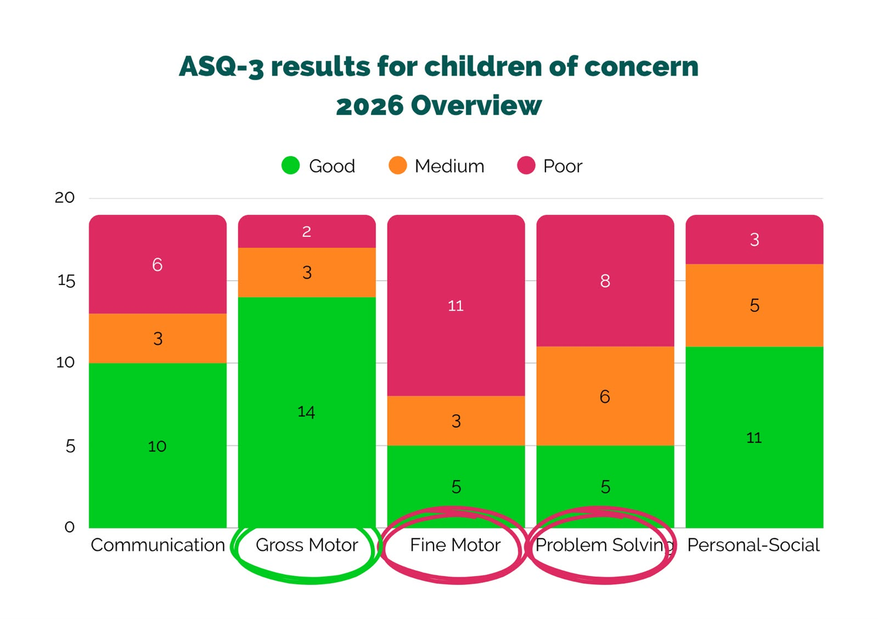
Follow-up:
Step 2
WHAT DID ASQ-3 TELL US?
ASQ-3 screens developmental progress across 5 domains w/ parent-completed questionnaire.
19 children screened:
  2 children (11%) showed no areas of concern.
  Areas of greatest developmental concern: Fine motor skills and problem-solving.
  14 children (74%) showed significant delays in both fine motor skills and problem-solving.
  7 children (37%) showed significant delays in drawing a person.
Follow-up and support:
  4 children (20%) newly referred to the Inclusion Programme for additional support.
  5 children (25%) flagged for continued observation and follow-up with their families to monitor progress and identify ongoing support needs.
The next stage was using ASQ-3 to build a more detailed picture of individual children’s strengths and areas of difficulty.

Slide 10
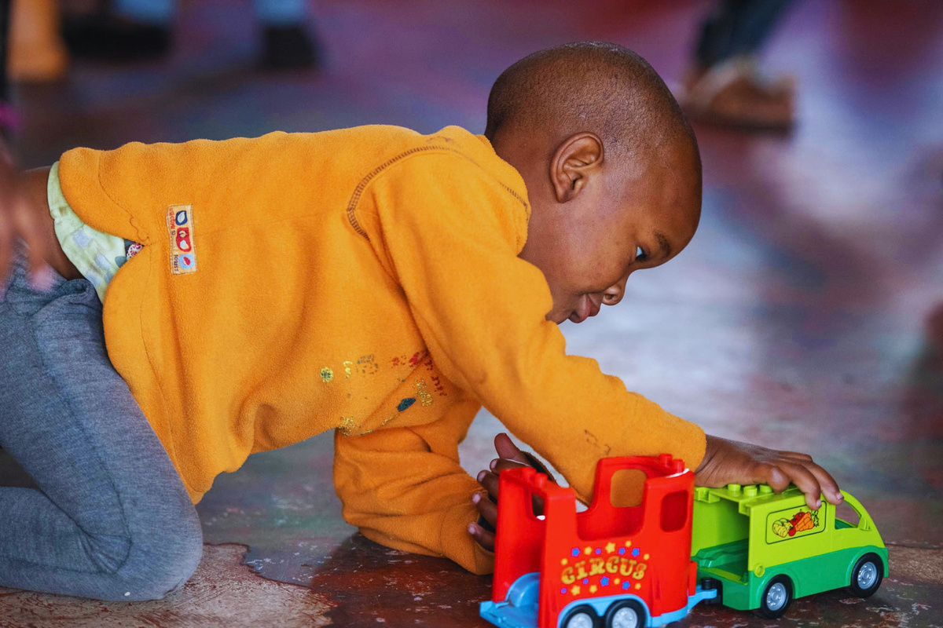
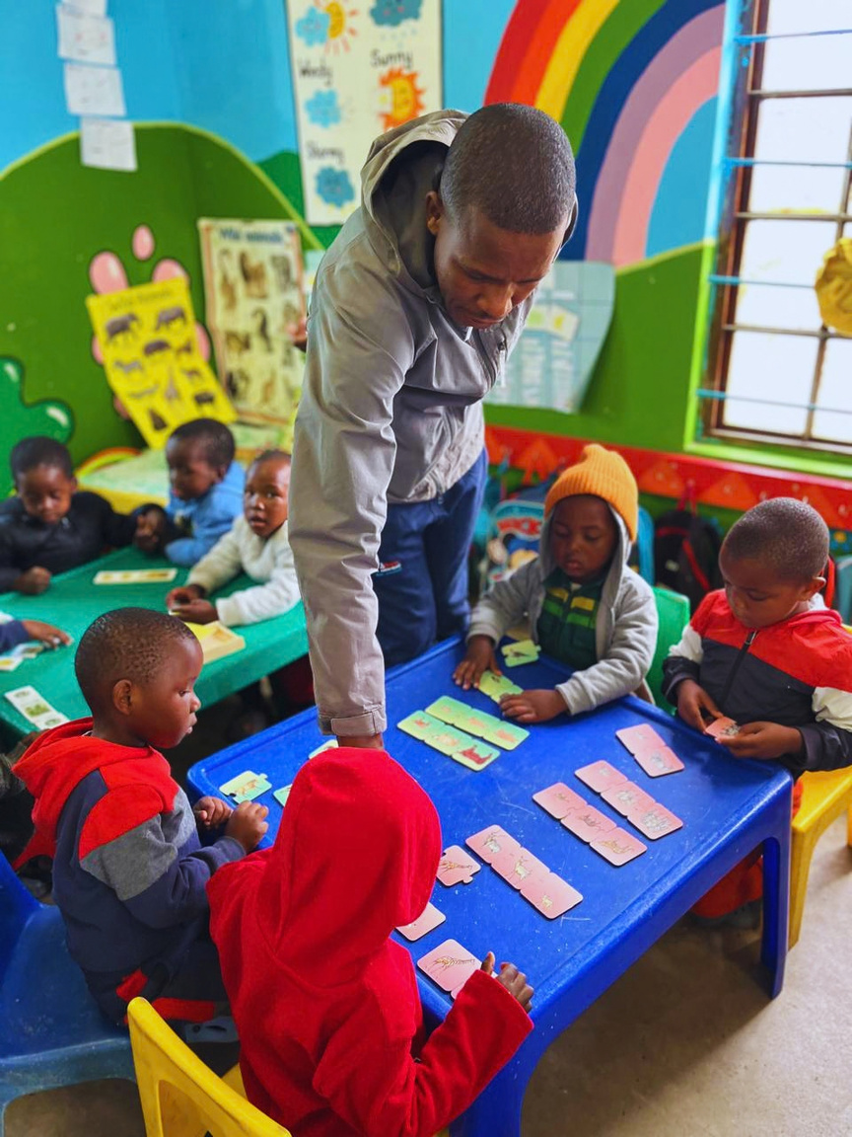
WHAT ARE WE LEARNING?
Key takeaways:
1. Screening tools can complement each other.
2. Identification does not equal understanding.
3. Less visible difficulties need attention too.
4. The process after screening matters.
5. The ELOM TT flagged the need for targeted
support and sped up identification.
6. The ASQ-3 provided eye opener moments for family members,
which encouraged them to accept additional support.
What’s next?
Explore wider use of ELOM TT.
Include children excluded through WHO disability screening in follow-up support.
Complete ASQ-3 assessments for children needing further investigation.
Strengthen family engagement and escalate access to available services.
Explore how DataDrive findings can clarify individual needs, including less visible disabilities.
  Key question: How can we identify children earlier and move more effectively from screening to the right support?

Slide 11



A FINAL THOUGHT…
The ELOM 4–5 tool used in the Thrive by Five study has not yet included children with disabilities or functional difficulties. Our pilot explores how children with disabilities can be included in future national studies, ensuring their developmental needs are recognised and informing planning for inclusive early learning and support services.
THANK YOU!
“We must work together to prevent disabilities through proactive health measures while creating inclusive environments for all children.
Early identification of disabilities combined with timely intervention services can mitigate long-term
impacts on children's development.“
— Extract from Hold My Hand campaign, National Strategy to Accelerate Action for Children (2026)
For more info:
Cathy Mather-Pike
Director and Founder
cathy@siyakwazi.org
0712746285
www.siyakwazi.org

